Slide 1


Trackin!T
Management System
This program is for development teams, customer service departments, delivery notification systems, or Field Fore Automation companies to create tickets and as they close those items they can mark them open, closed, under development and gives a workflow that allows the development manager to see the process for the overall project
Project designed by
Notes:
Ideas:
Trapper Keeper App

Slide 2
A STEP-by-STEP Build of this project
1. Design Home Page
2. Create Database in SQL
3. Connecting Database
4. Design Form for Users Module
5. Create Business Logic Layer – BLL
6. Create Methods to Users
7. Adding ADD, UPDATE, DELETE for Users
8. Upload Images
9. Add Search Functionality for Users
10. Design Form for Customer Module
11. Create BLL for Customer Module
12. Create Methods to Customers
13. Create ADD, UPDATE, DELETE for Customers
14. Upload Profile Picture for Customers
15. Refresh Dashboard on Database Change
16. Add Search Functionality for Customers
17. Design Login Form
18. Add Login Functionality
19. Saving and Displaying Logged in Users
20. Create Animated – Loading Progress – Splash Screen
21. Delete Image File
22. Bug Fixing

Slide 3
A STEP-by-STEP Build of this project
1. Design Home Page
2. Create Database in SQL
3. Connecting Database
4. Design Form for Users Module
5. Create Business Logic Layer – BLL
6. Create Methods to Users
7. Adding ADD, UPDATE, DELETE for Users
8. Upload Images
9. Add Search Functionality for Users
10. Design Form for Customer Module
11. Create BLL for Customer Module
12. Create Methods to Customers
13. Create ADD, UPDATE, DELETE for Customers
14. Upload Profile Picture for Customers
15. Refresh Dashboard on Database Change
16. Add Search Functionality for Customers
17. Design Login Form
18. Add Login Functionality
19. Saving and Displaying Logged in Users
20. Create Animated – Loading Progress – Splash Screen
21. Delete Image File
22. Bug Fixing

Slide 4
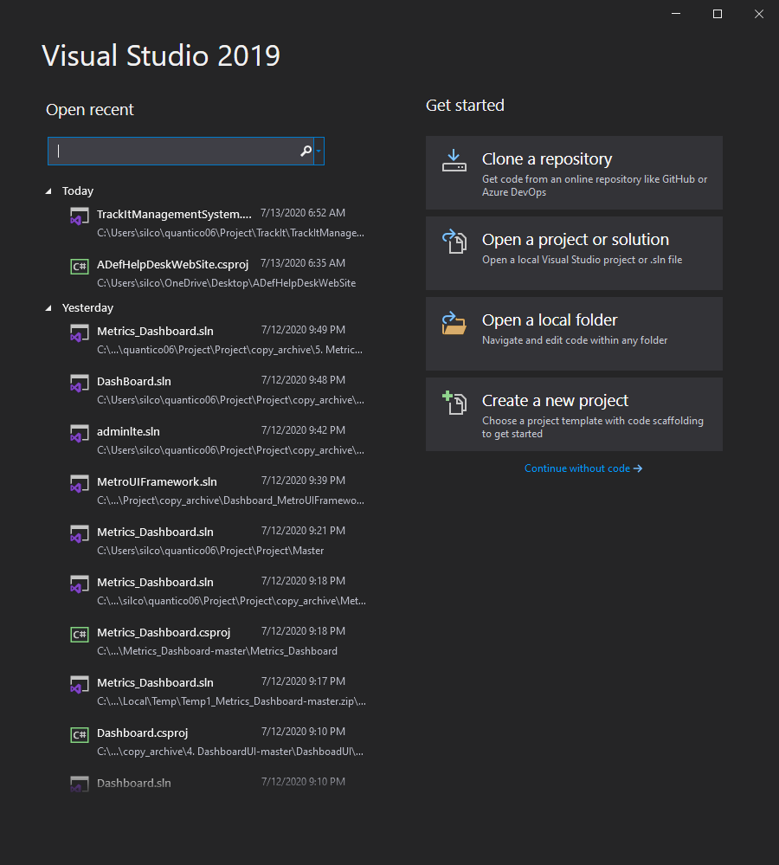
Start Visual Studio
Open Visual Studio
Click on the create a new project

Slide 5
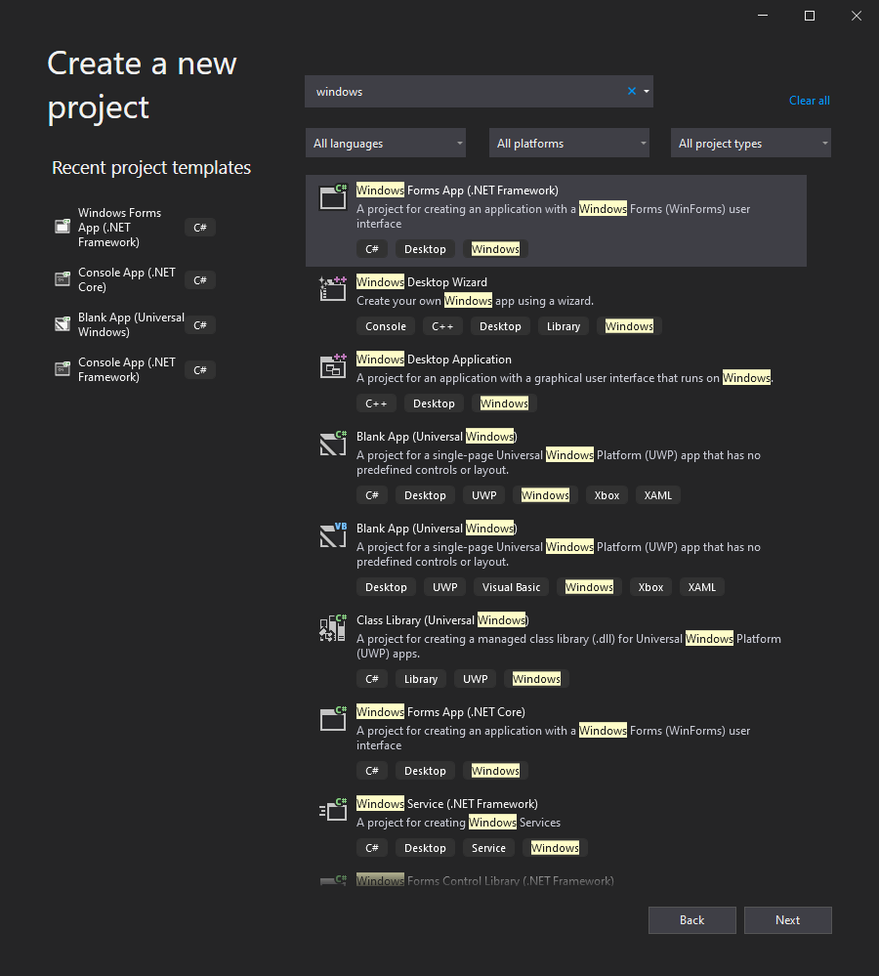
Select Template
Choose a template
Click on the Windows Forms App (.NET Framework) for C#
If you don’t see it, you can type it in the search block on the top
Click Next

Slide 6
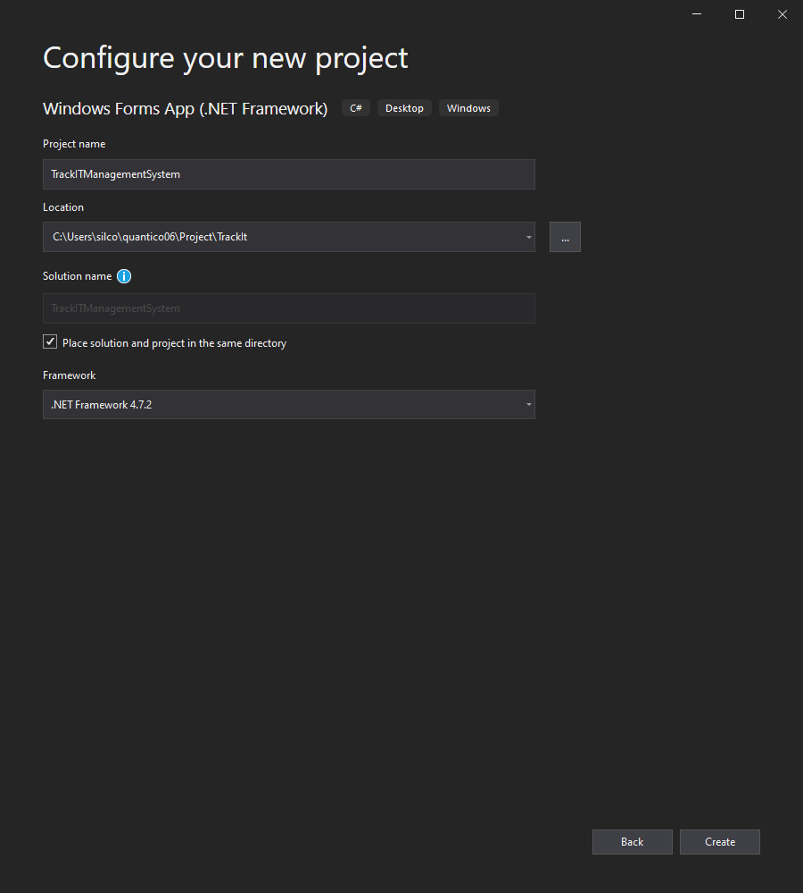
Configure
Configure your new project
Choose a project name, use Pascal name convention
Choose save destination
Have check for solution in the same directory
Create

Slide 7
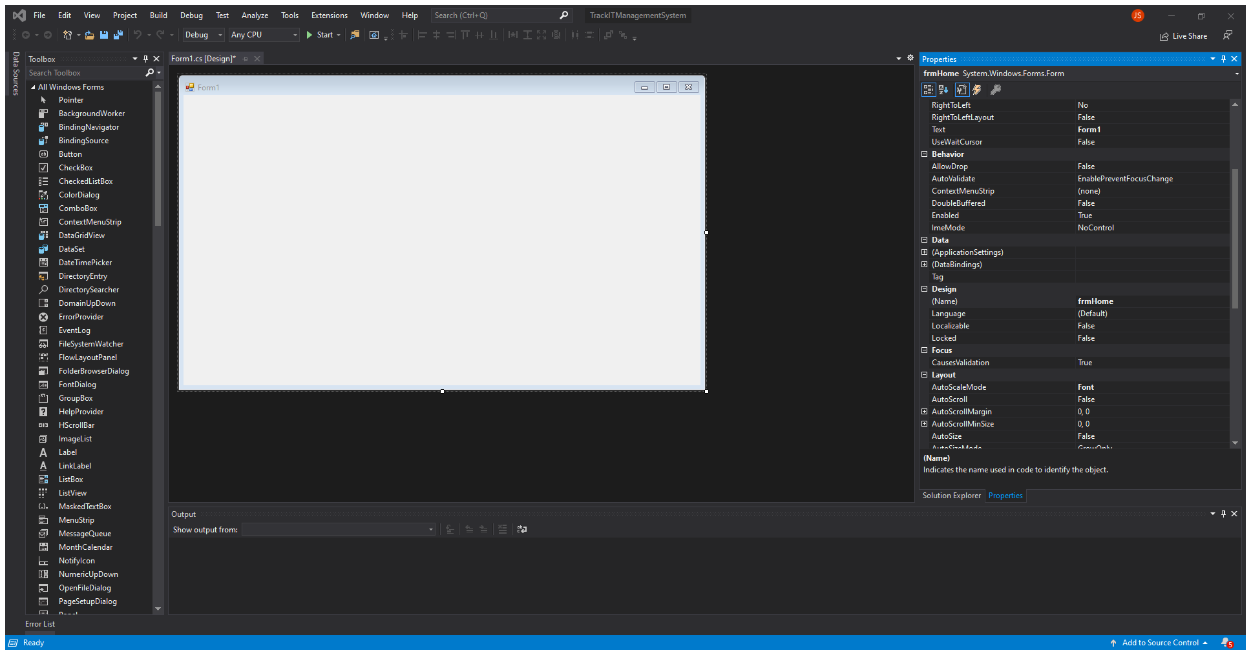
Rename Window
Rename the design
Find the design name and rename it using camel case convention

Slide 8
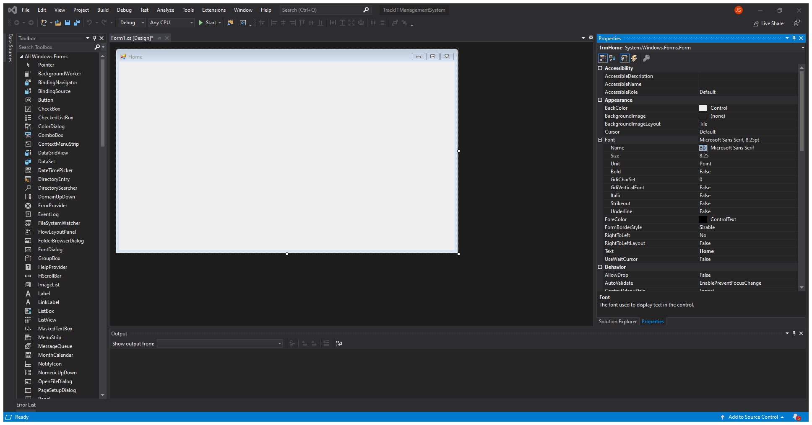
Rename Text
Rename the text
Find the text and rename it using Pascal case convention

Slide 9
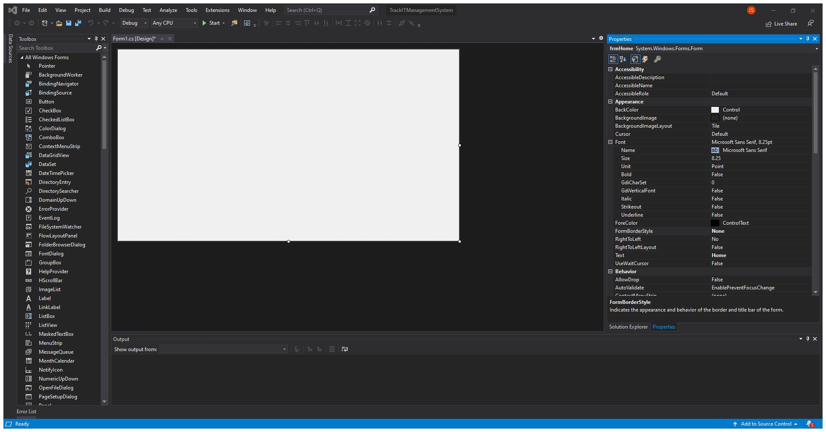
Change Border
Change Border Style
Change to None

Slide 10
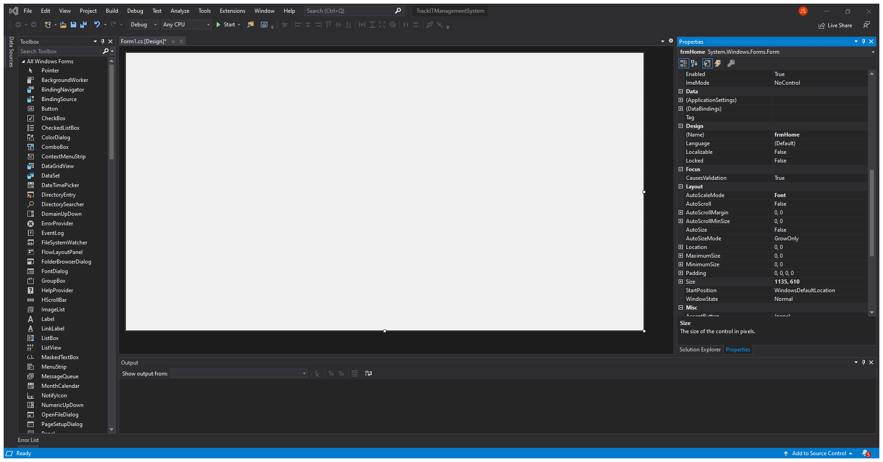
Change Size
Change Window Size
Change to 1135, 610
This is in pixels

Slide 11
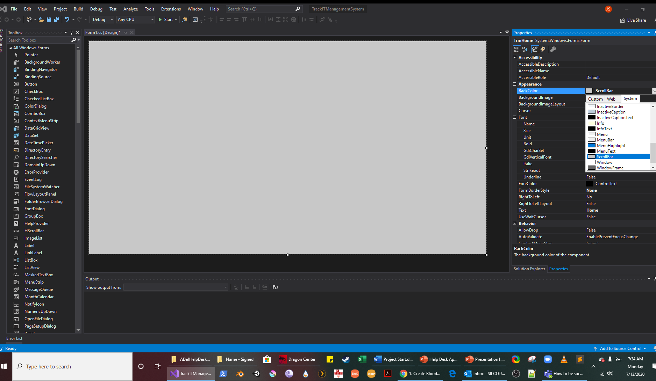
Change Back Color
Change Window BackColor
Use drop down and select ScrollBar

Slide 12
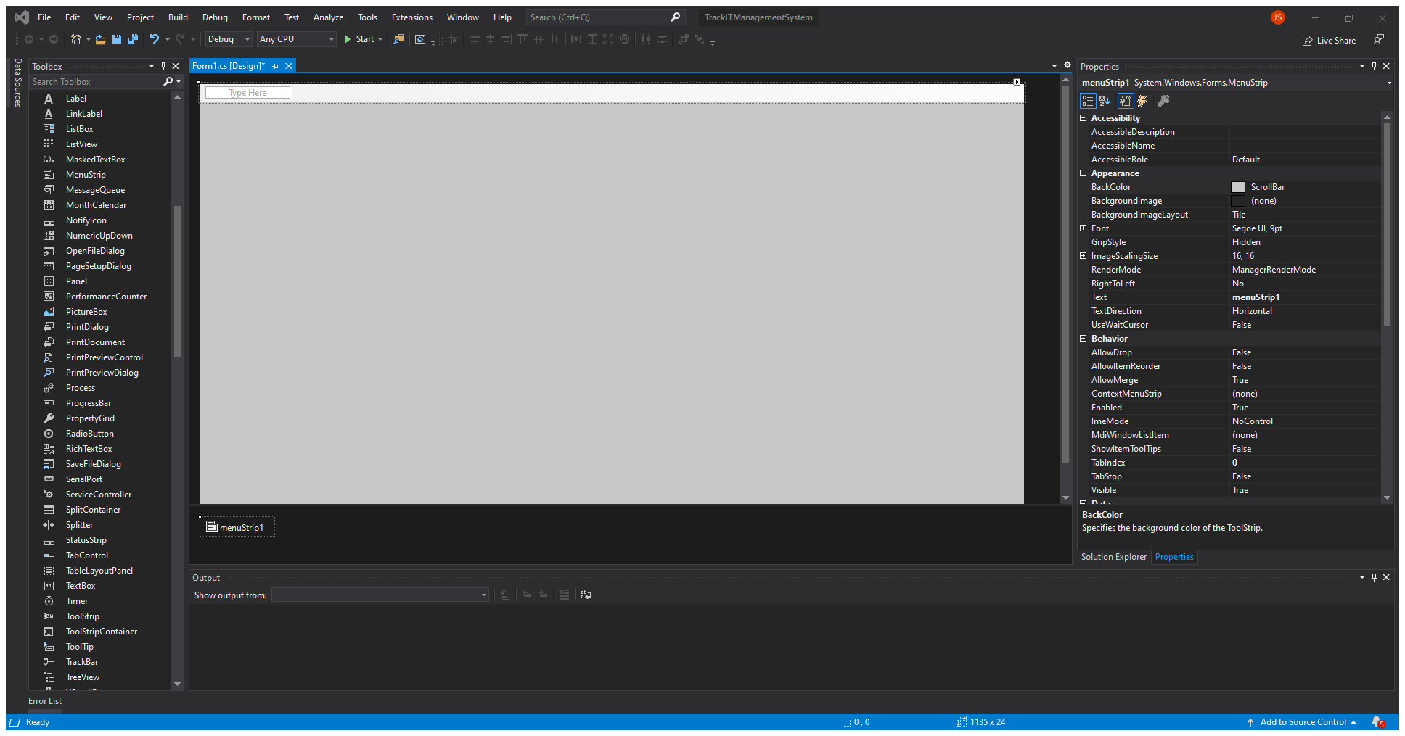
Add Menu Strip
Add Menu Strip
Select the MenuStrip from the Toolbox and drag it to the top of left of the window

Slide 13

Add Menu Names
Type in the new text box
Users
Then add another
Called Admin

Slide 14
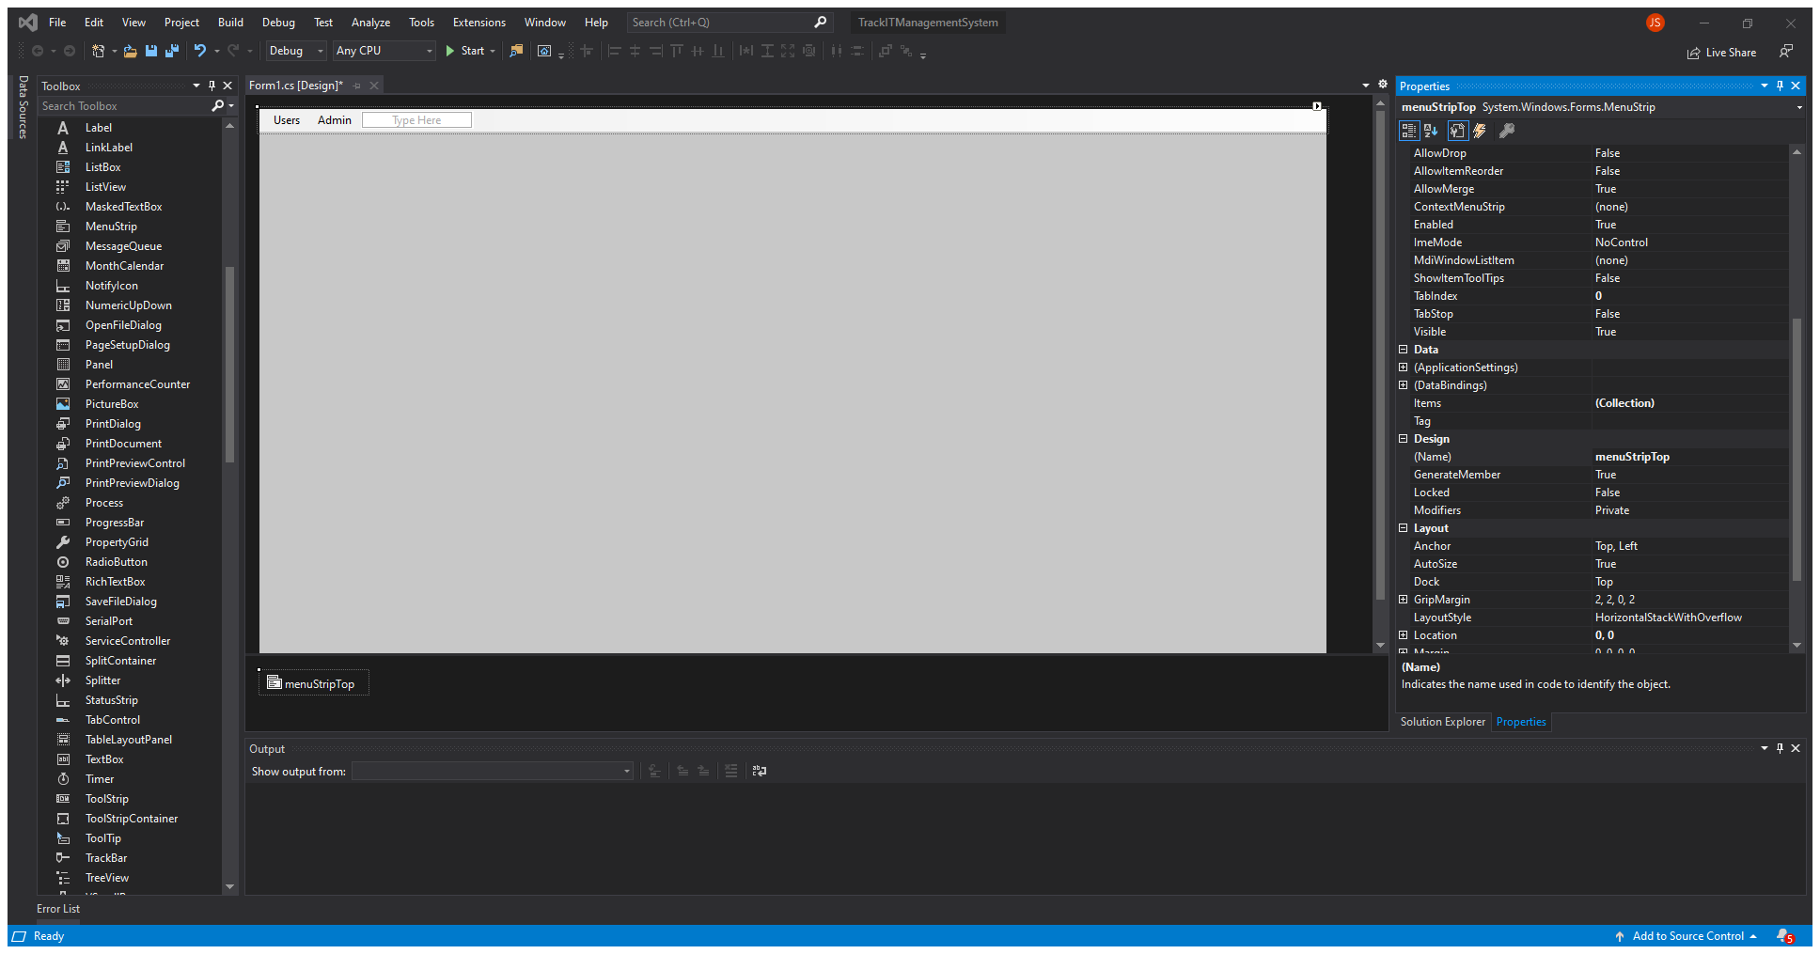
Rename Menu Strip
Rename the Menu Strip in Properties
Rename using camel case
Call it
menuStripTop

Slide 15

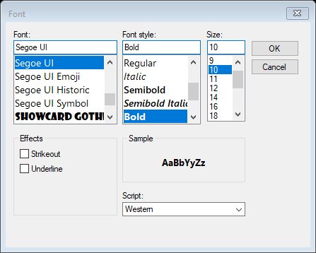
Change Font
Select the font selector in the properties
Change to:
Bold
Size 10

Slide 16

Change Padding
Change Menu Strip Padding
Use drop down and select ScrollBar

Slide 17

Add Panel
Add Panel from Toolbox
Drag and drop a panel in the lower left of the window

Slide 18
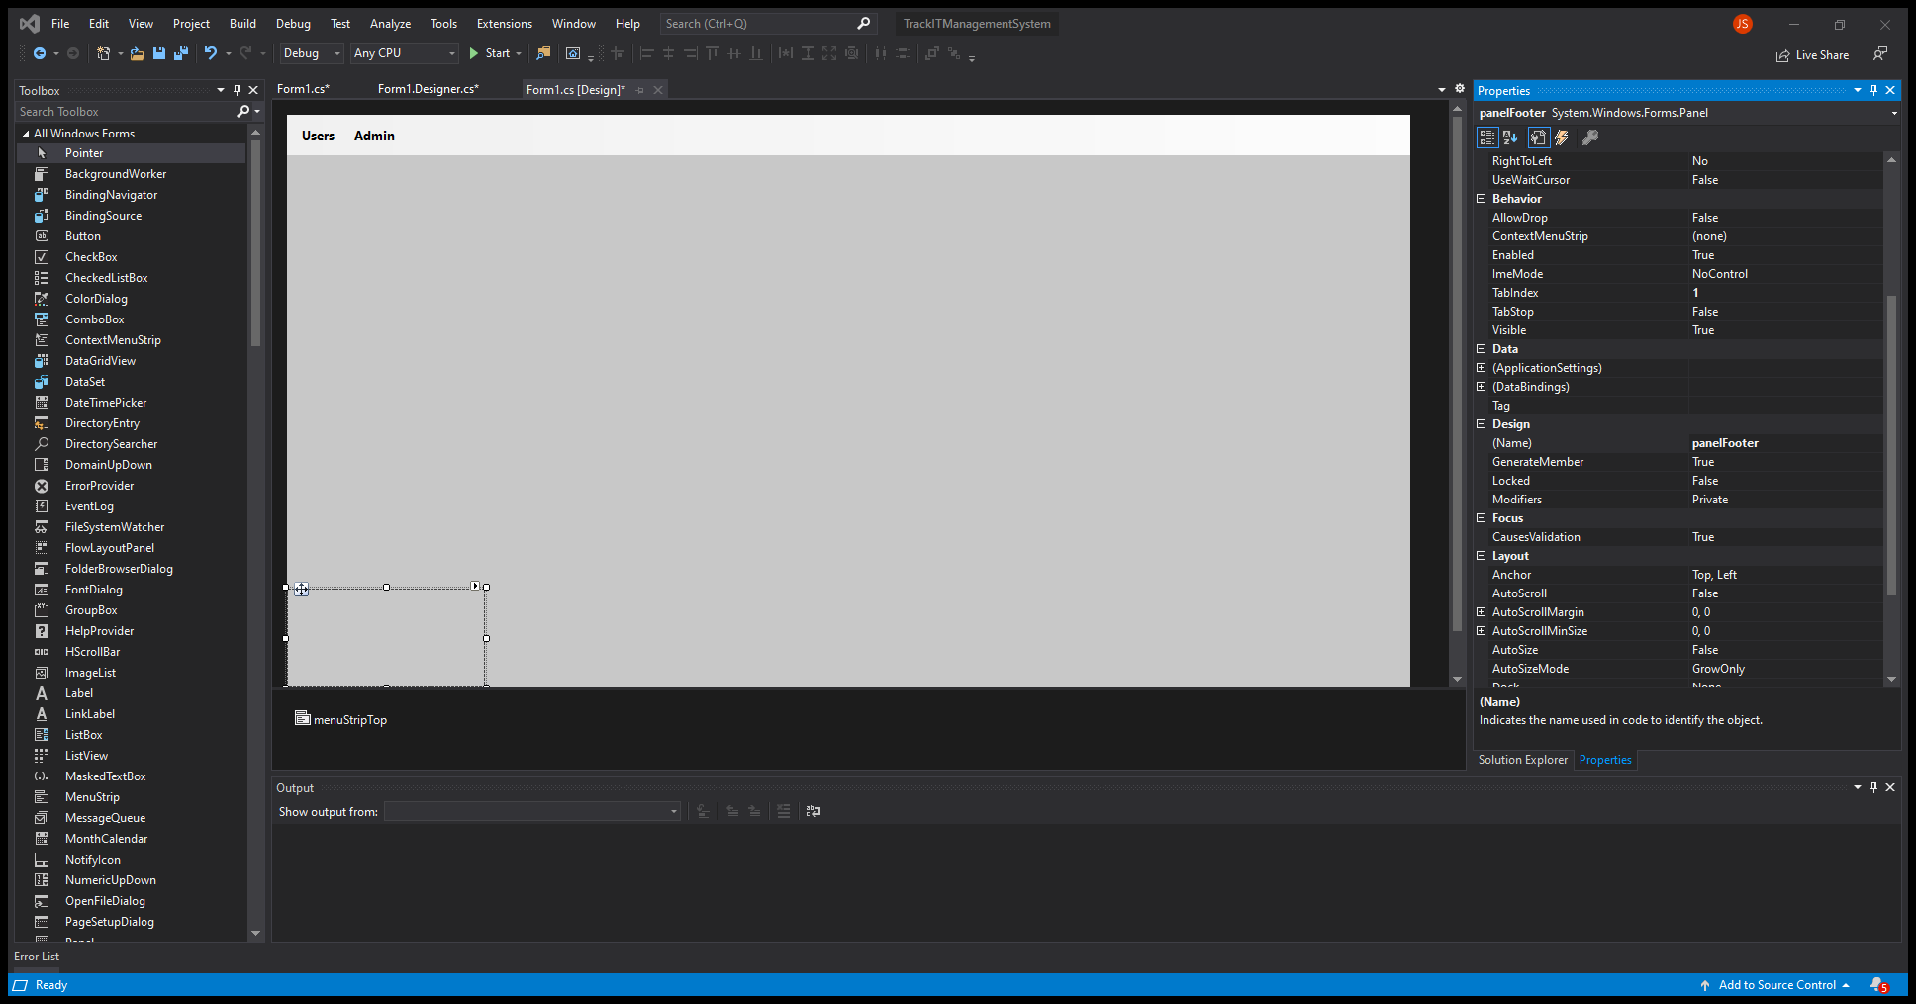
Rename Panel
Rename
In the properties name the panel:
panelFooter

Slide 19
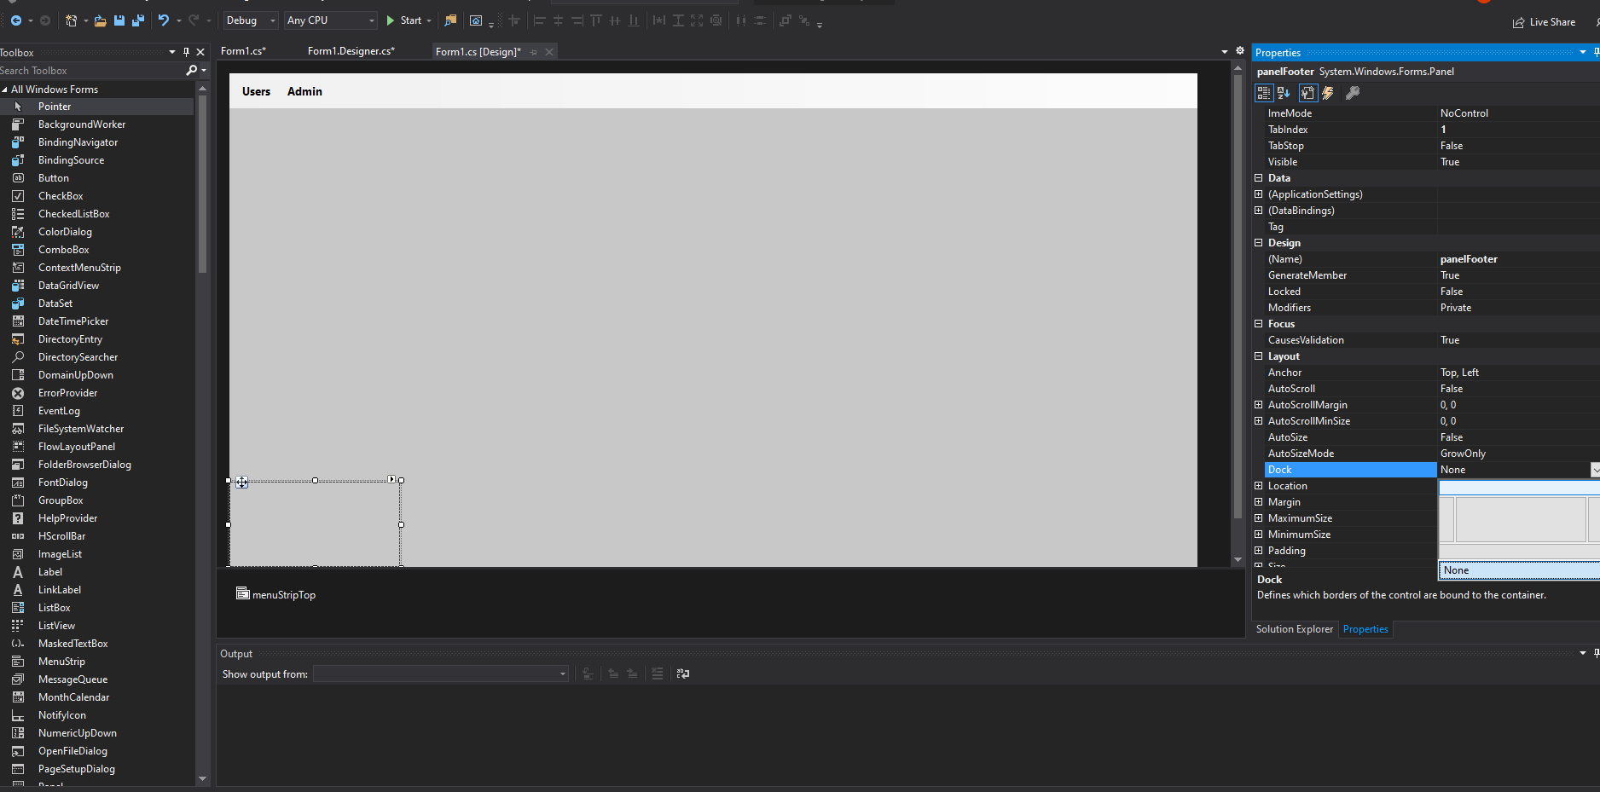
Add Button
Add a button
Under Properties
Select

Slide 20
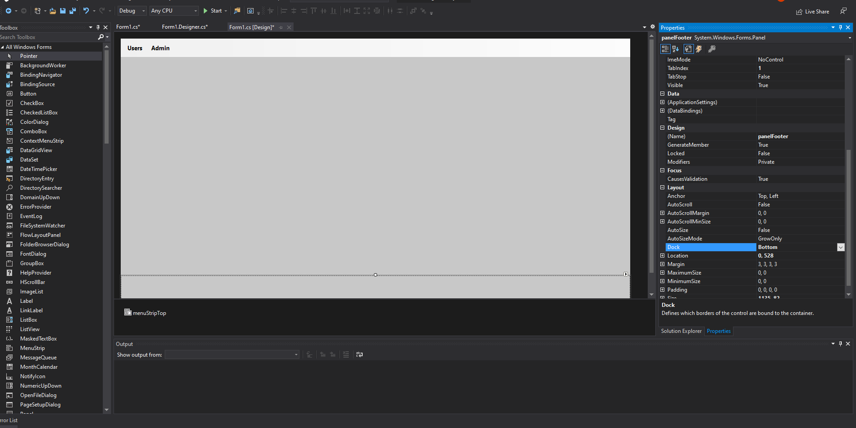
Resize Panel
Resize the panel
Use the panel selection to resize and make the same size (close enough) to match the size of the top menu strip

Slide 21
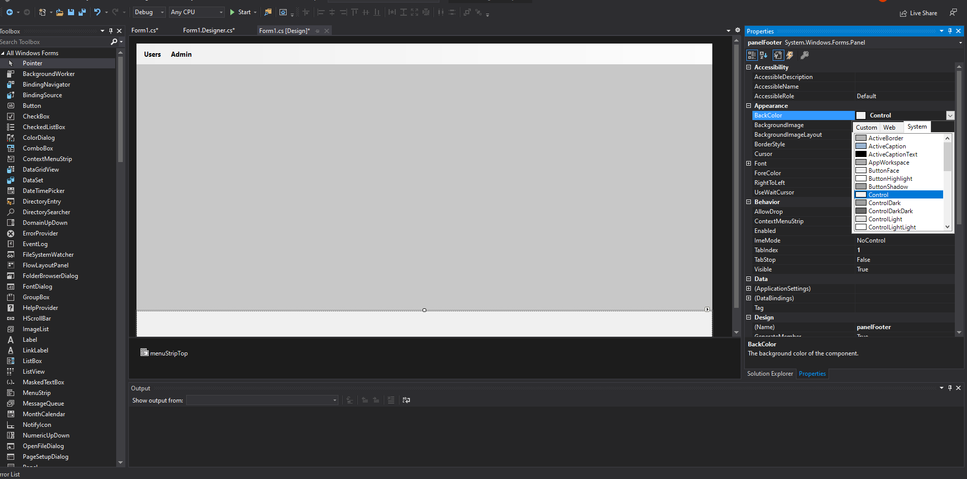
Change Back Color
Change Panel BackColor
Use drop down and select Control

Slide 22
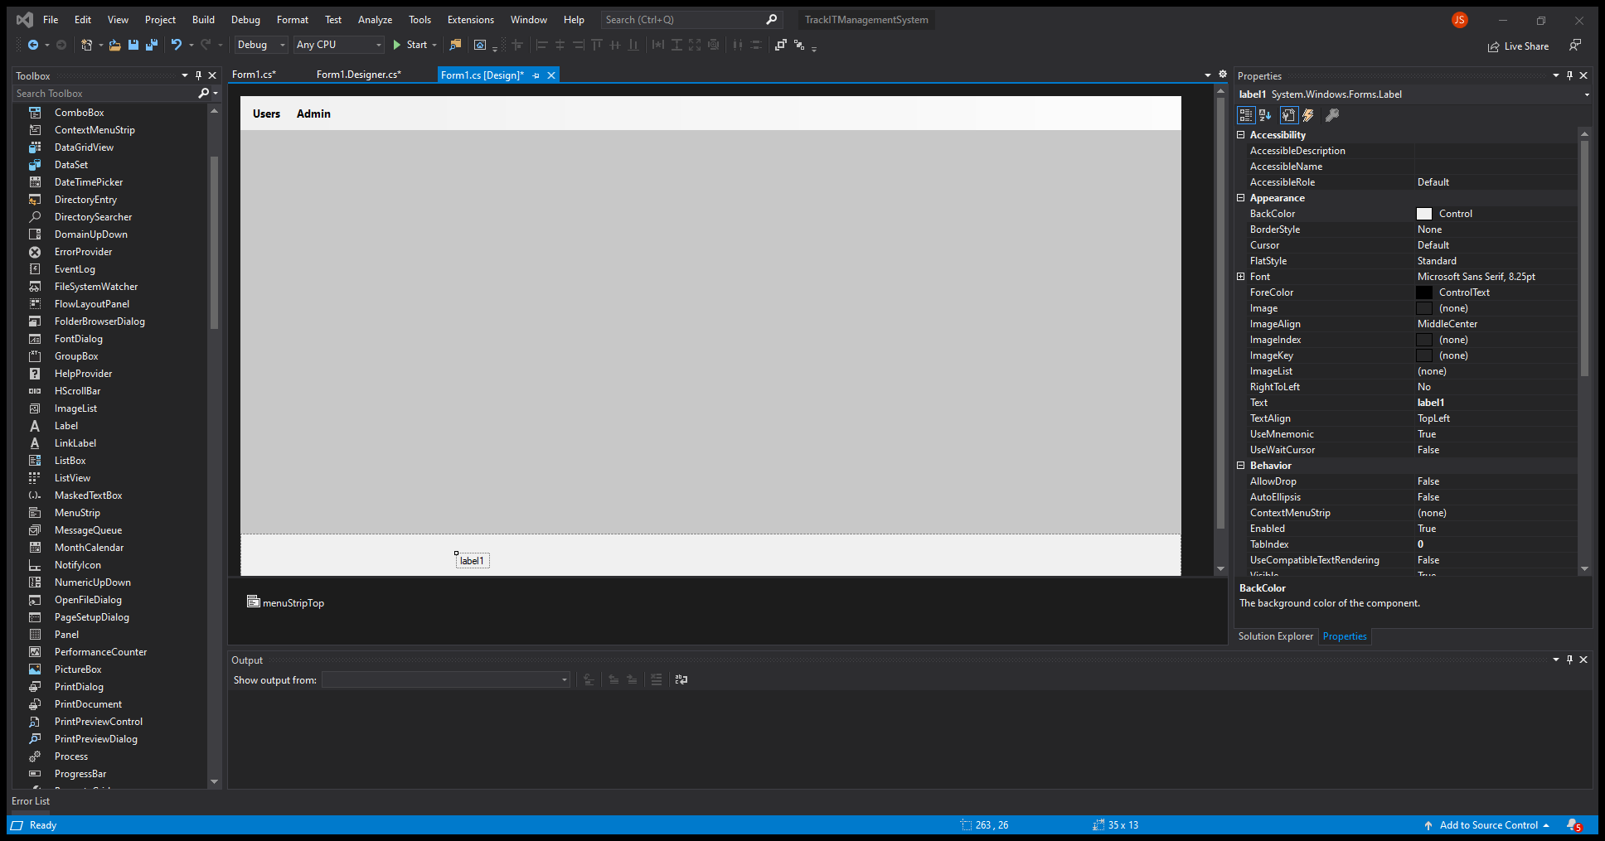
Add a label
Select label from toolbox
Drag and drop it on the panel

Slide 23
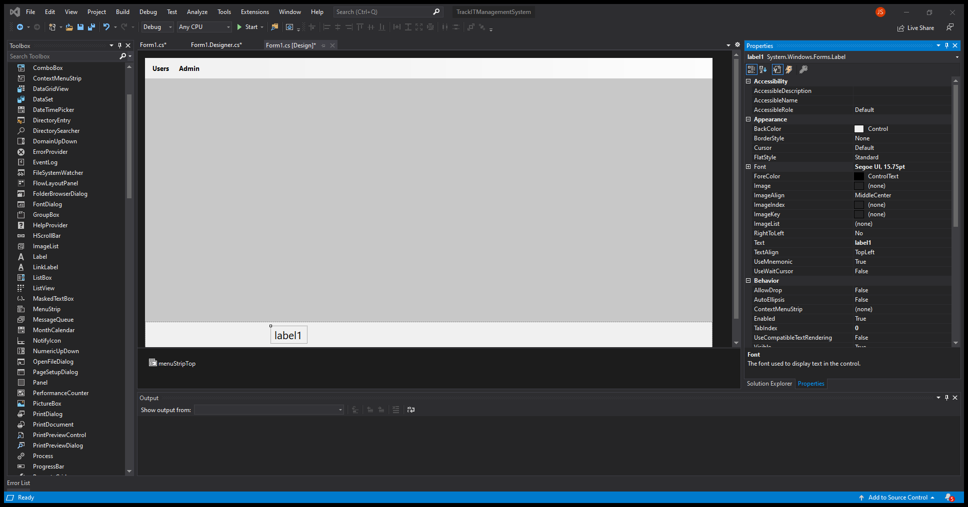
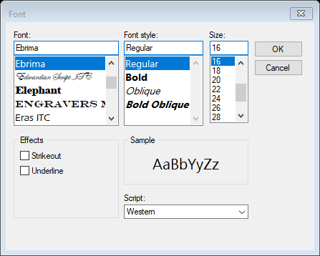
Change Font
Select the font for the label
Change the font to Ebrima
Size to 16

Slide 24
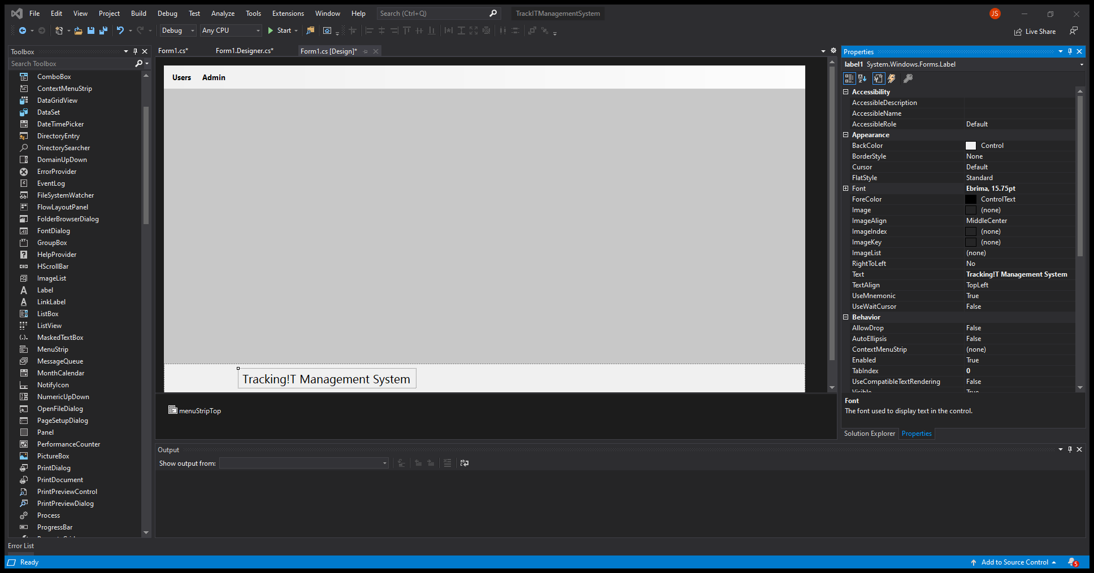
Rename Text
Rename label text
Name it:
Tracking!T Management System

Slide 25
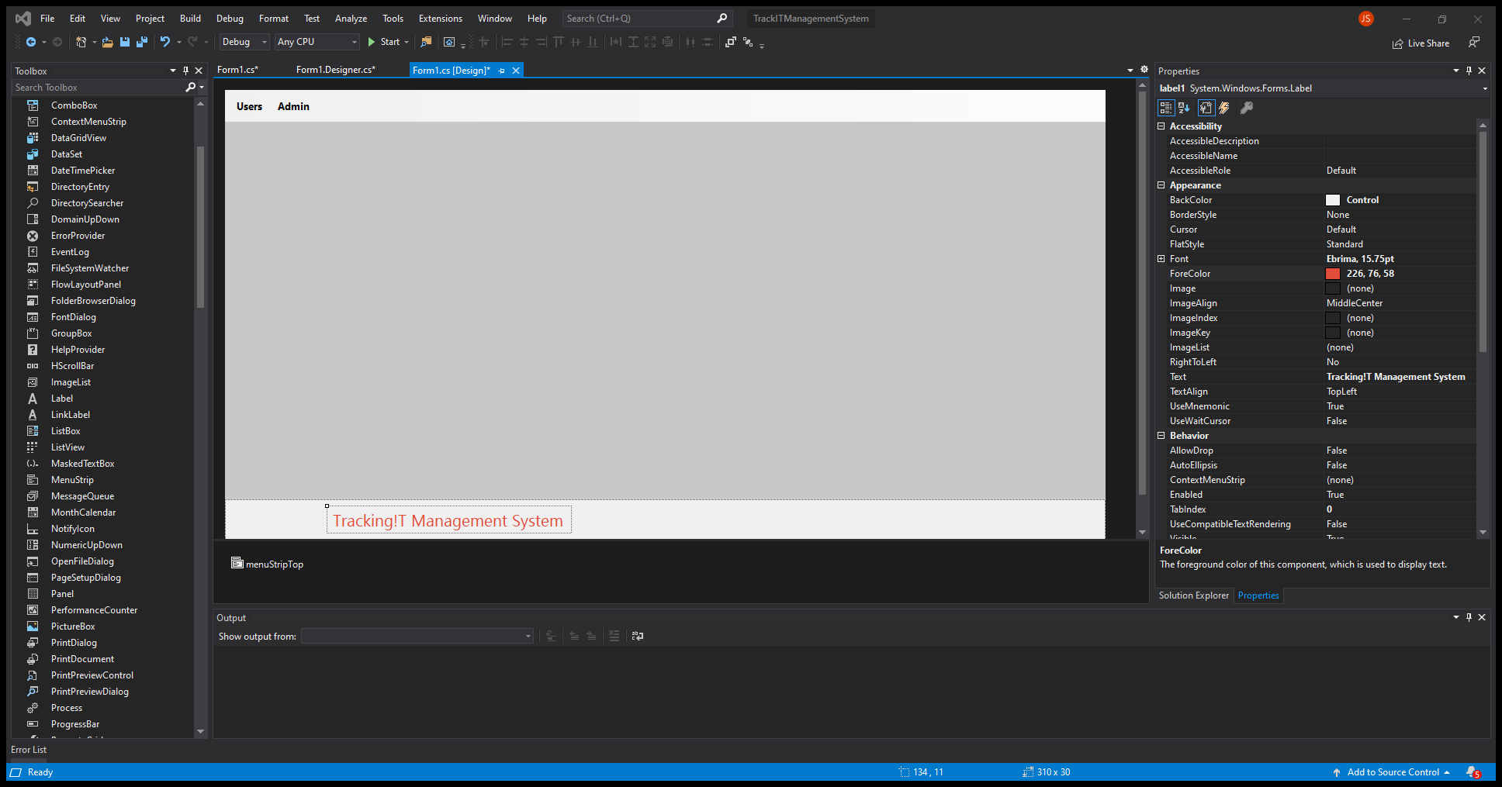
Change Text Color
Select Font ForeColor
Write inside the name box:
226, 76, 58

Slide 26
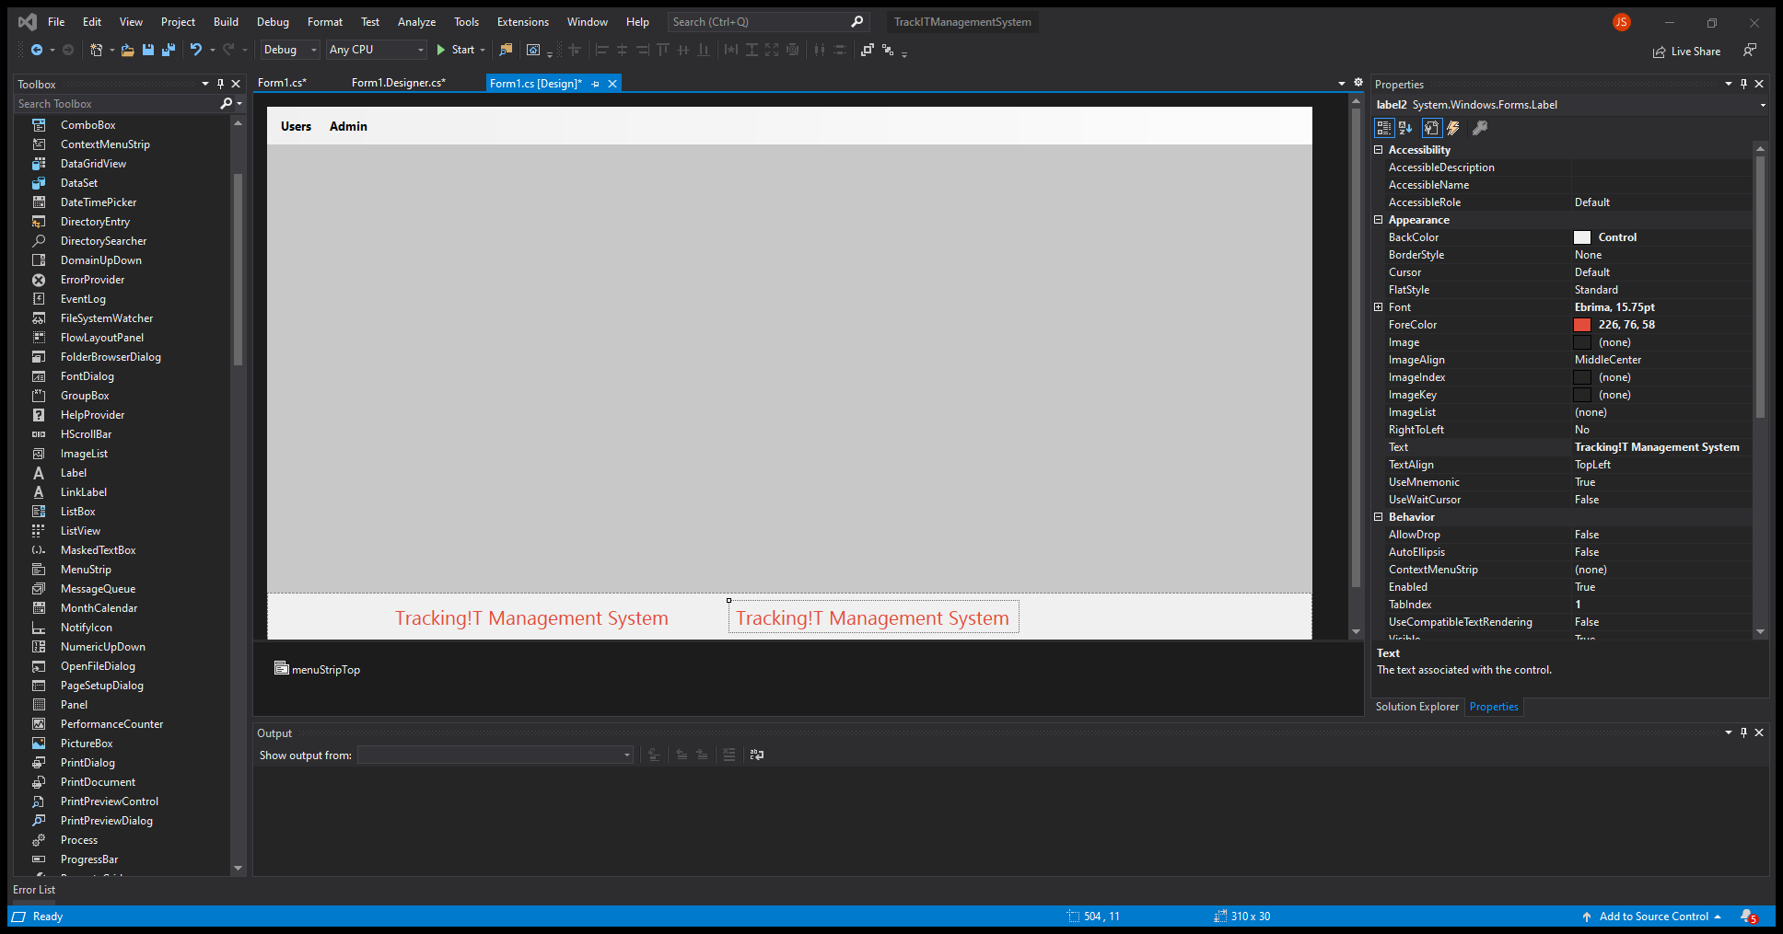
Add Label
Copy and Paste the label
Select the label and copy it
Ctrl-c
Crtl-v

Slide 27
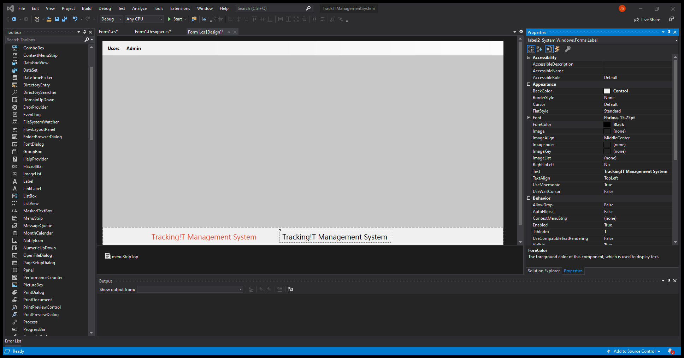
Change Text Color
Select Font ForeColor
Select the web color:
Black

Slide 28

Change Label Text
Change Label Design Name
Rename it to:
lblDevTitle

Slide 29
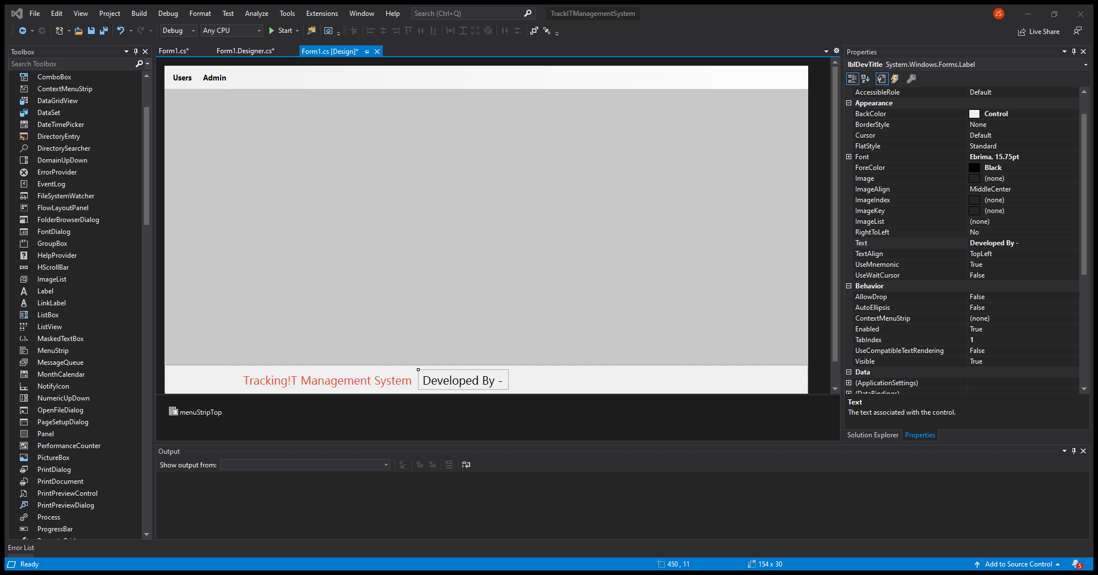
Change Label Text
Change Label Text Name
Rename it to:
Developed By -

Slide 30
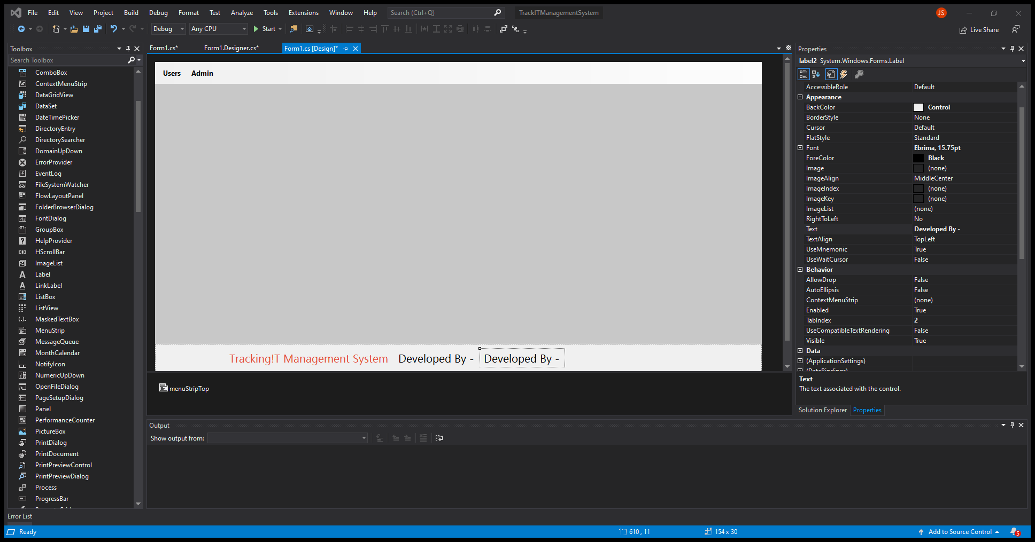
Add Label
Copy and Paste the label
Select the label and copy it
Ctrl-c
Crtl-v

Slide 31

Rename Label
Rename Design Text
lblDeveloper

Slide 32
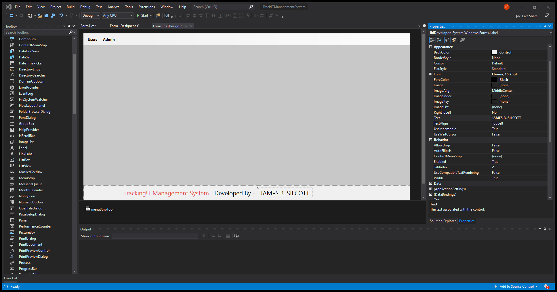
Rename Label
Rename Font Text
Insert Name:
James B. Silcott

Slide 33

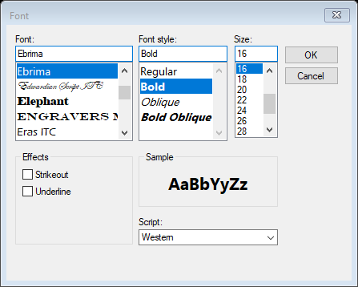
Change Font
Change Font
Select Bold

Slide 34
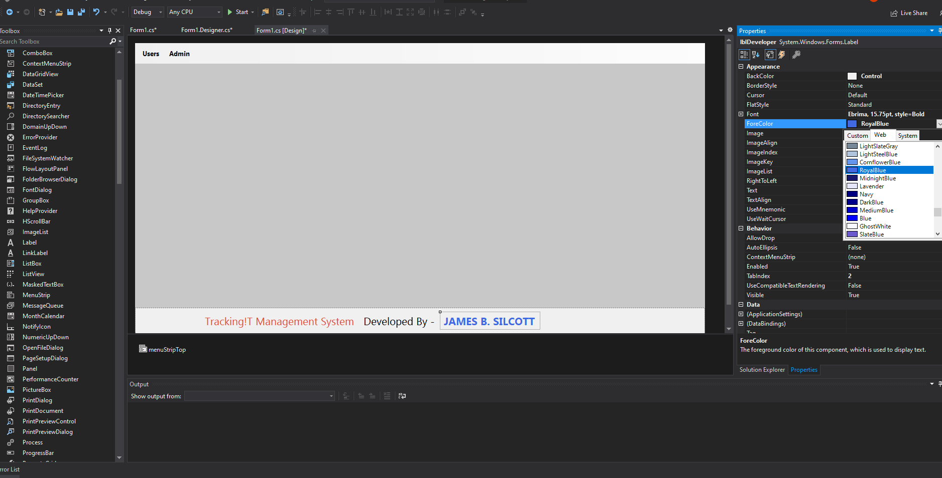
Change Font Color
Change Font Color
Select Royal Blue

Slide 35
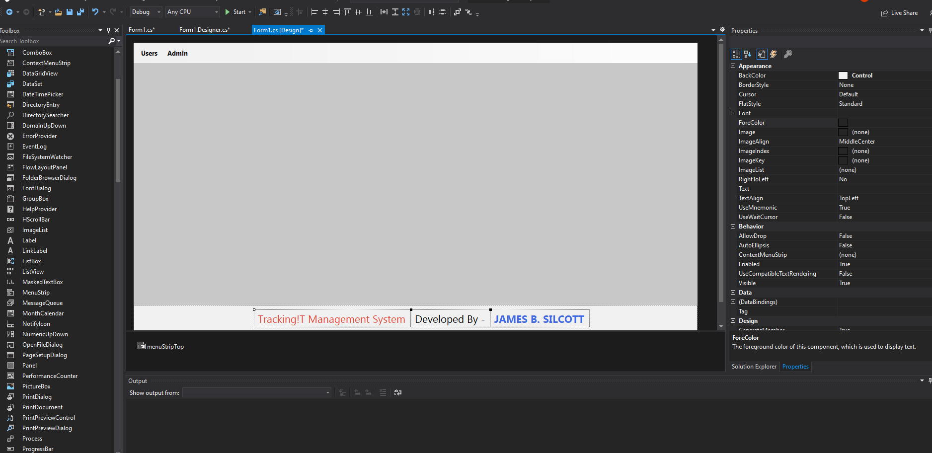
Re-position
Select all the labels
Move and align in the missile of the panel

Slide 36
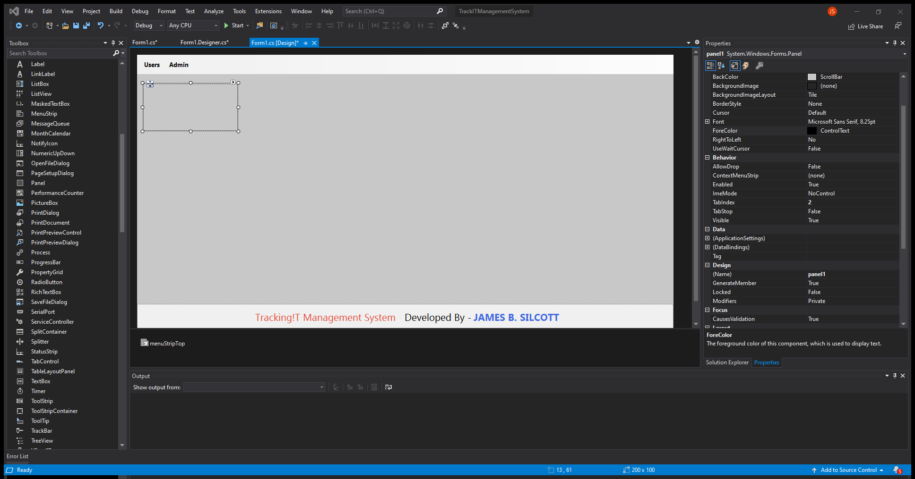
Add Panel
Select a panel from the toolbox
Drag and drop it on the left side of the window

Slide 37

Re-size the panel
Change the size if needed
200, 100

Slide 38
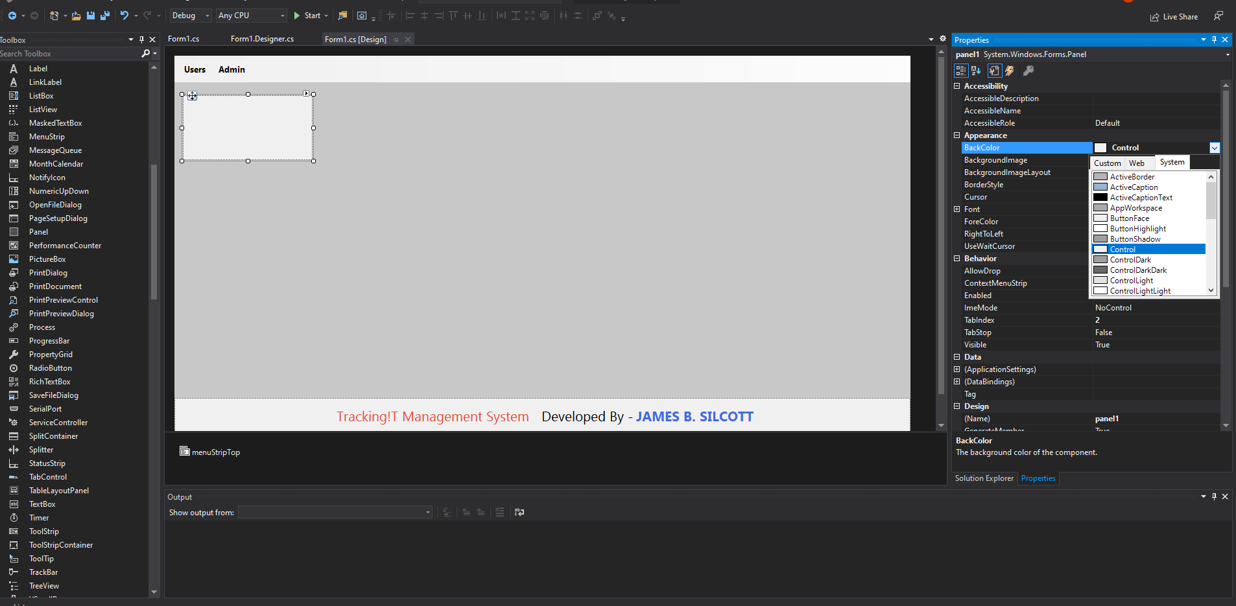
Change Panel Color
Change Panel BackColor
Change to Control color

Slide 39
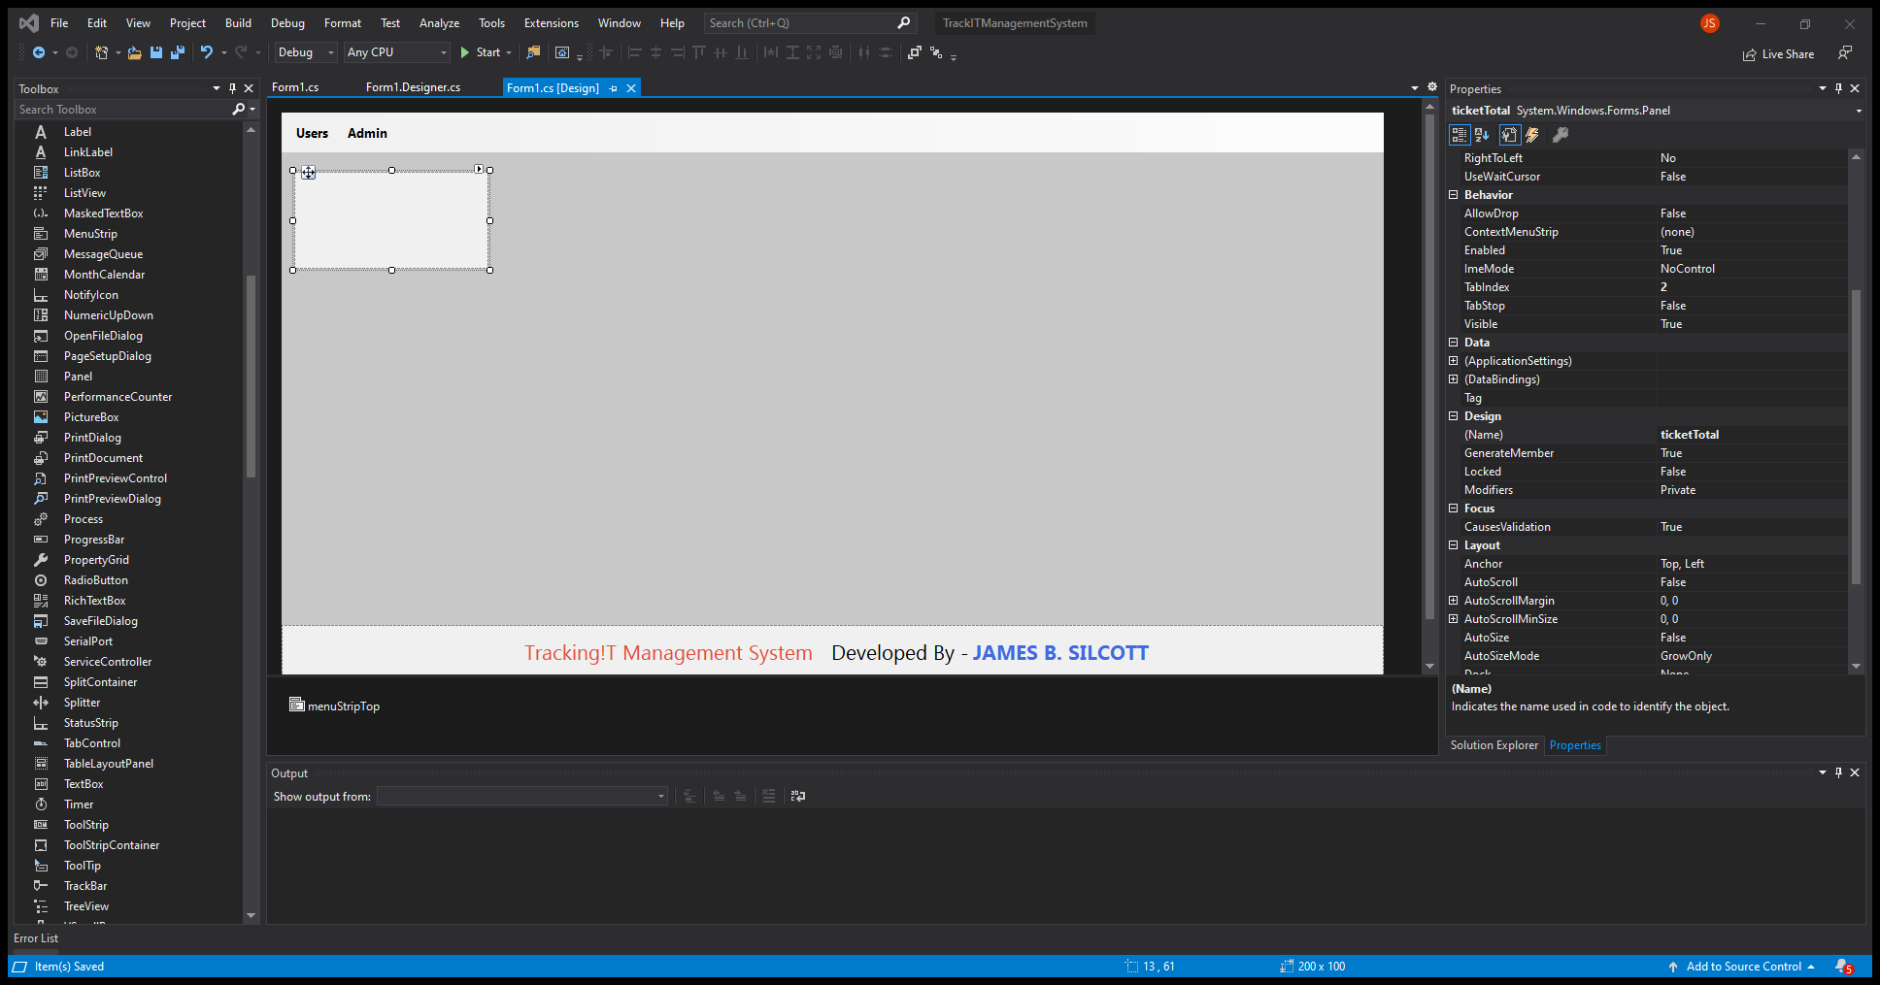
Rename the panel
Rename the design name
Call it:
ticketTotal

Slide 40
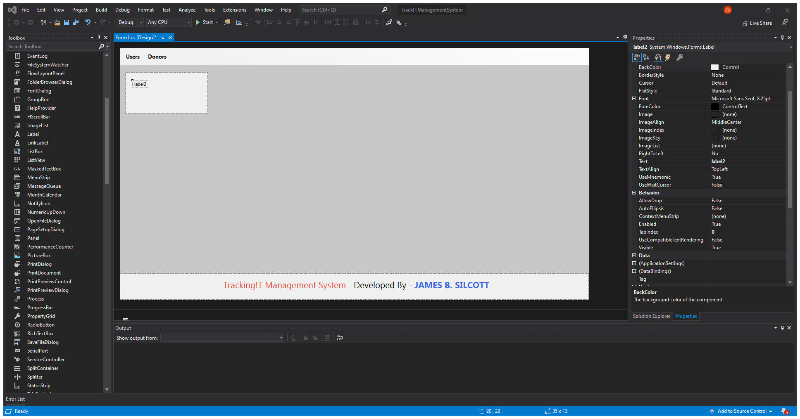
Add Label
Add a label
Drag and drop a label inside the panel

Slide 41
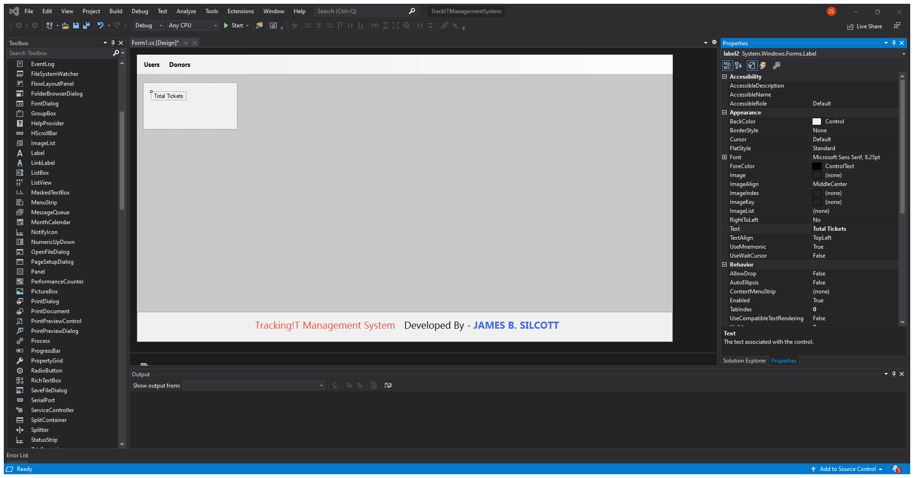
Rename Label
Change text label name
Call it:
Total Tickets

Slide 42

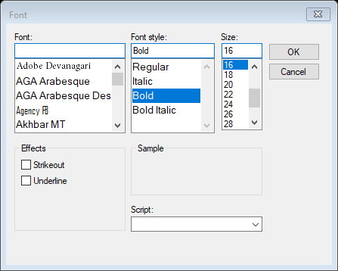
Change Font
Change Font
Change Font to:
Bahnschrift
Bold
16

Slide 43
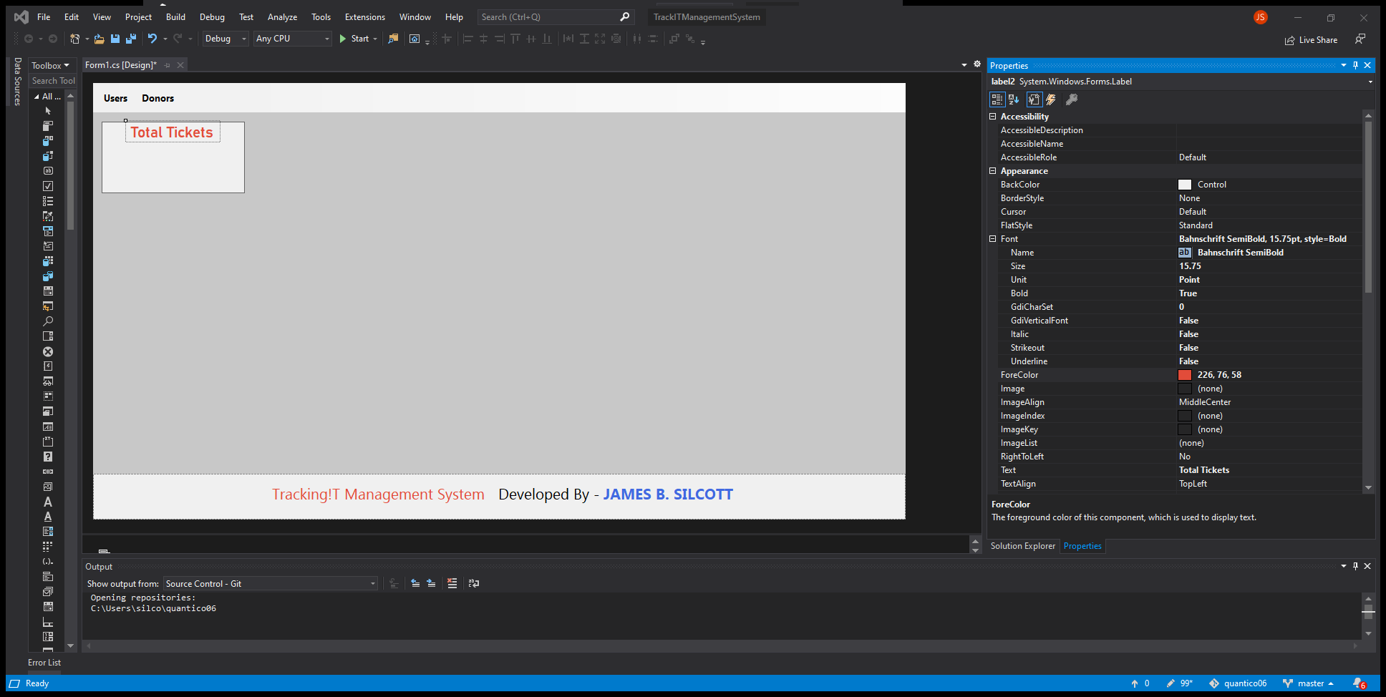
Change Text Color
Change color of text
Change the property of the forecolor to 226, 75, 58

Slide 44
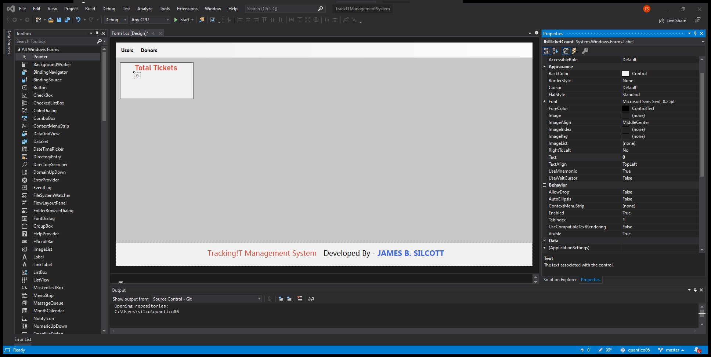
Add Label
Add a label
Change the Design binding name to lblTicketCount
Change the text name to “0”

Slide 45

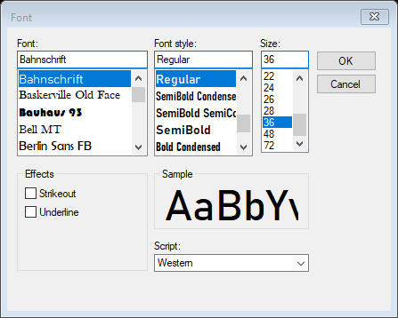
Change Font
Change Font
Size: 36
Font: Bahnschrift
Style: Regular

Slide 46

Change Color
Change Font Color
Change the color to:
226, 76, 58

Slide 47
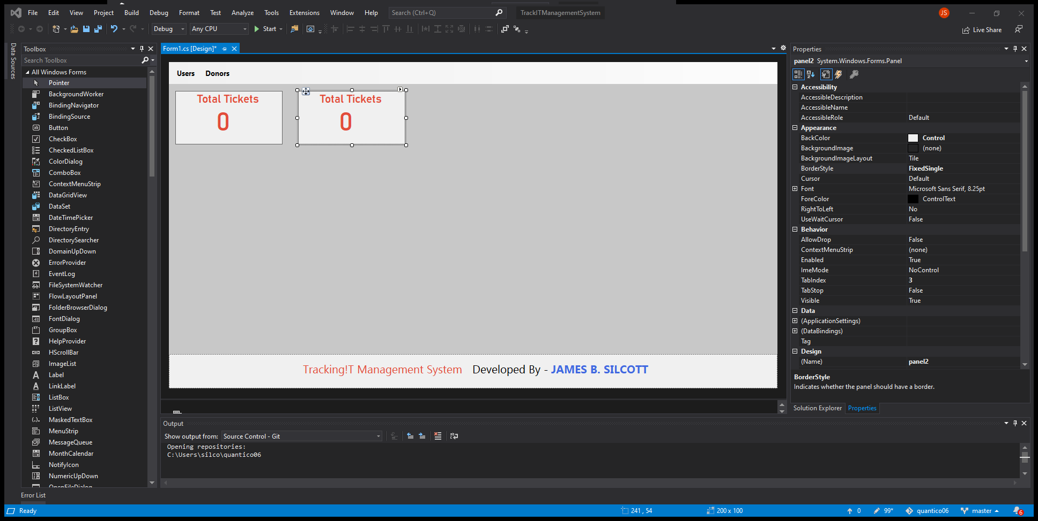
Copy
Select, copy and paste
Select the box and label
Ctrl-c
Ctrl-v
Place the new box next

Slide 48
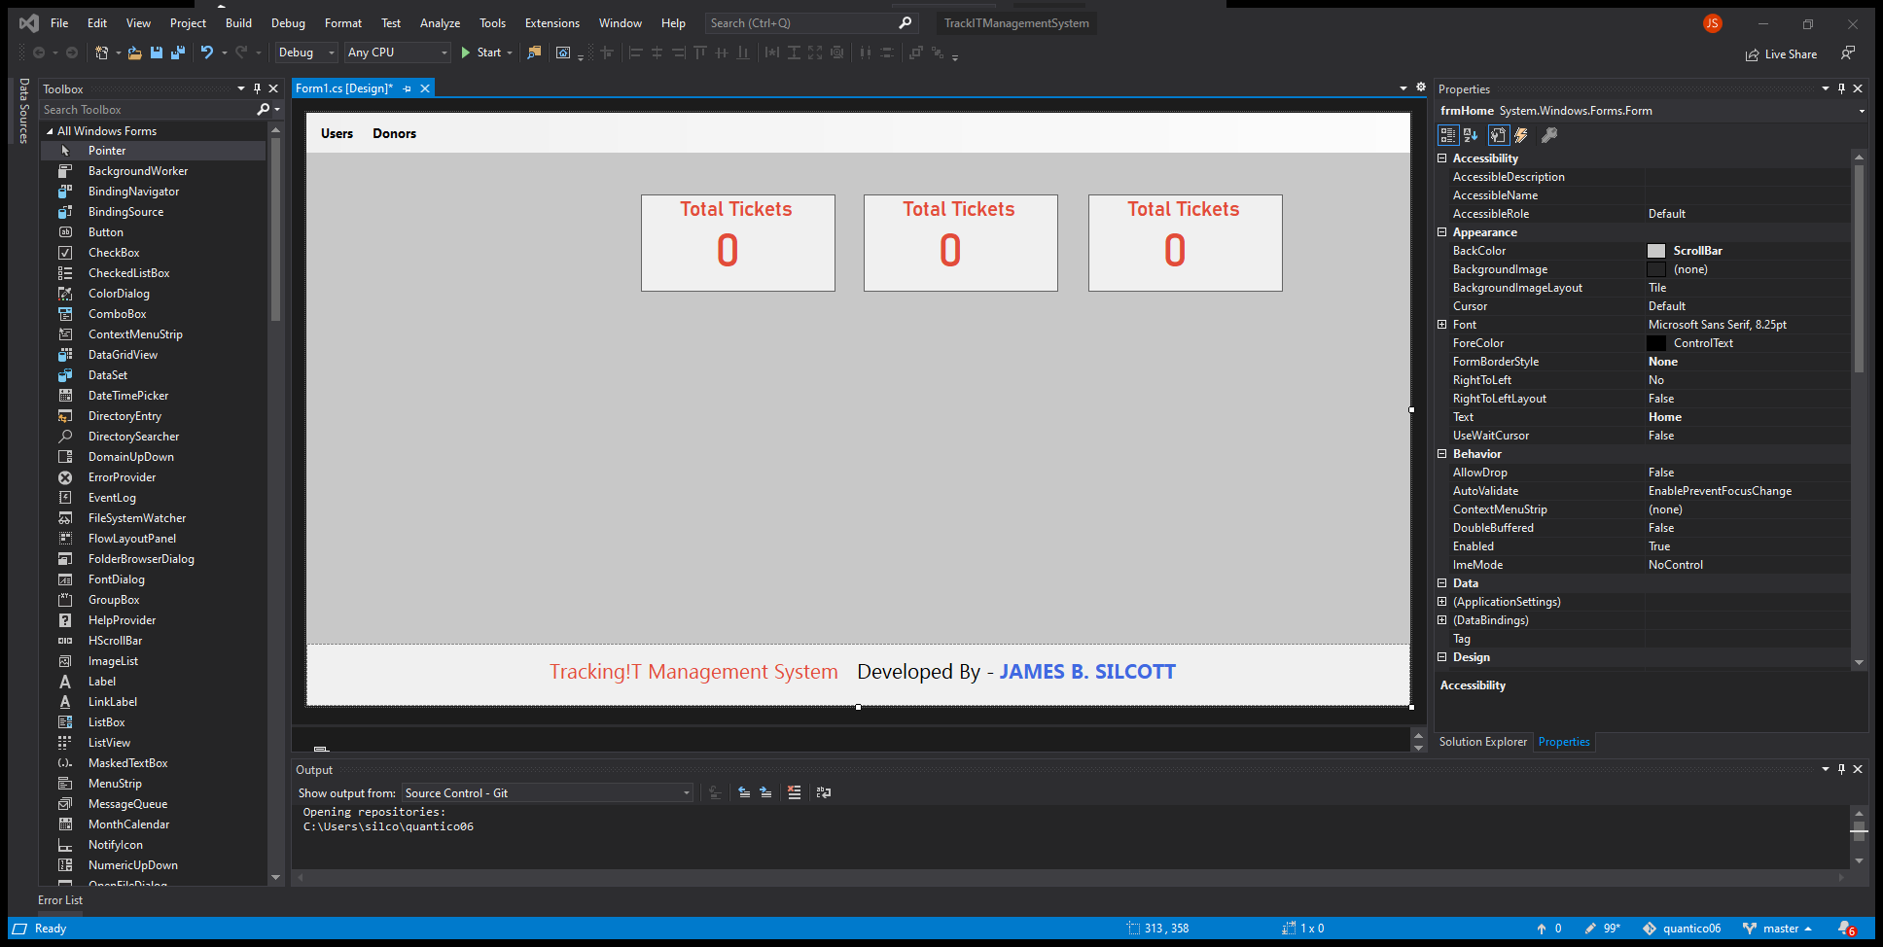
Copy again and move
Copy another and move all 3
Copy and paste another
Select all 3 and move over to the right side

Slide 49
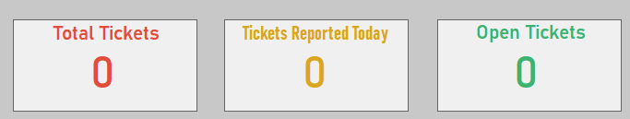
Change Names and Colors
Change the name of the other box and their colors

Slide 50
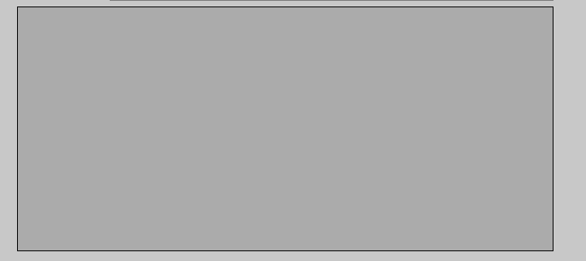
Add Data Grid View
Add a Data Grid View
Rename to dvgTickets

Slide 51
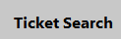
Add Label
Add a label
Rename to Ticket Search

Slide 52
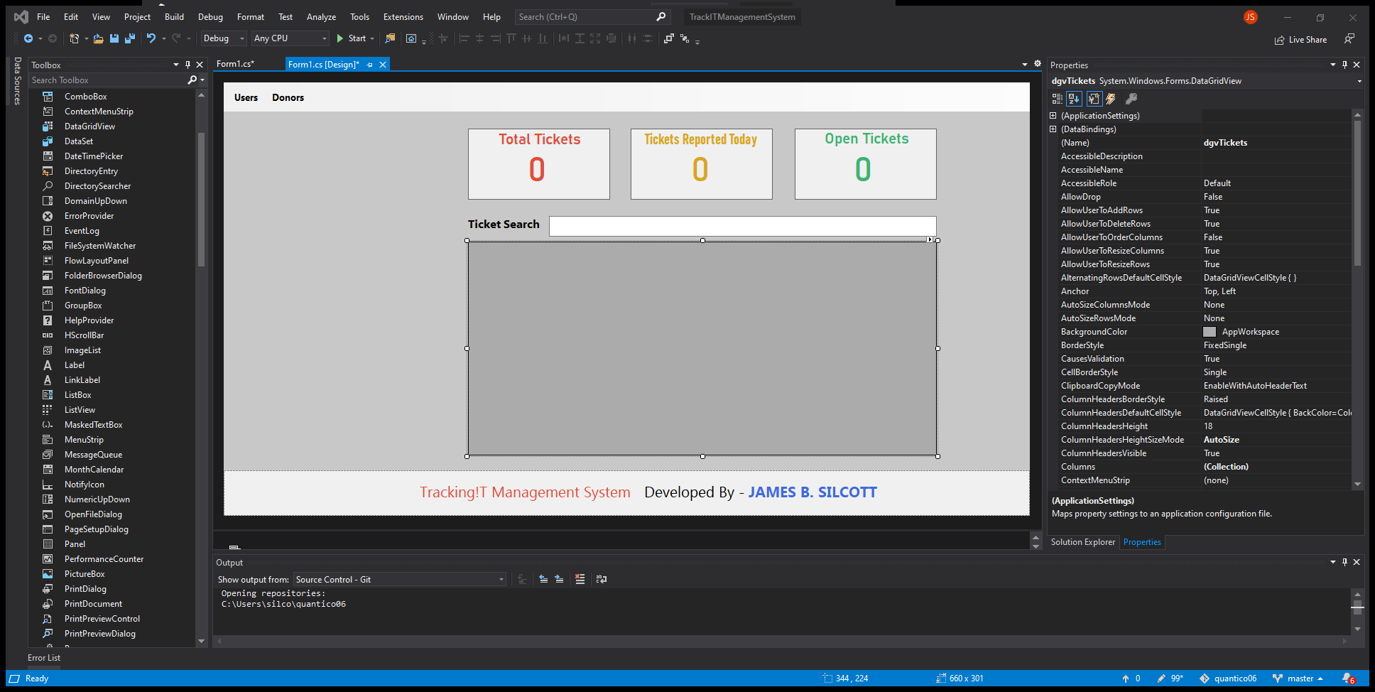
Add Text Box
Add a Text Box
Rename binding name to
txtSearch

Slide 53
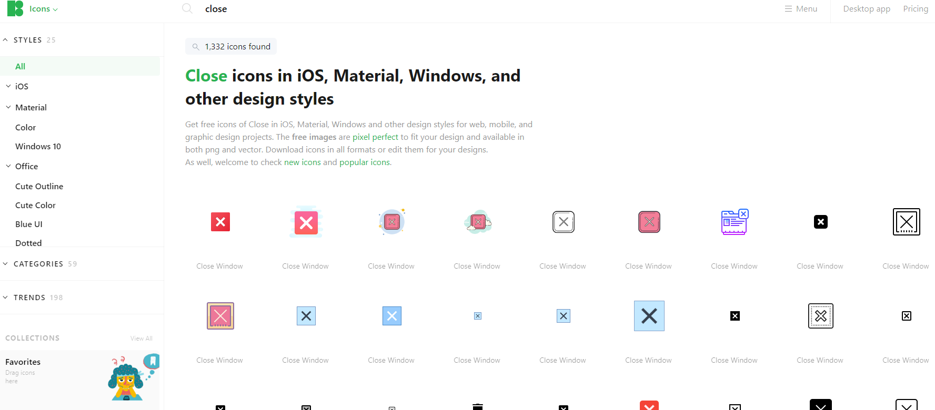
Find Icon
Download Icon
Go to
Icon8.com
Search for “close”
Download a close icon
Save it to a folder with this program

Slide 54
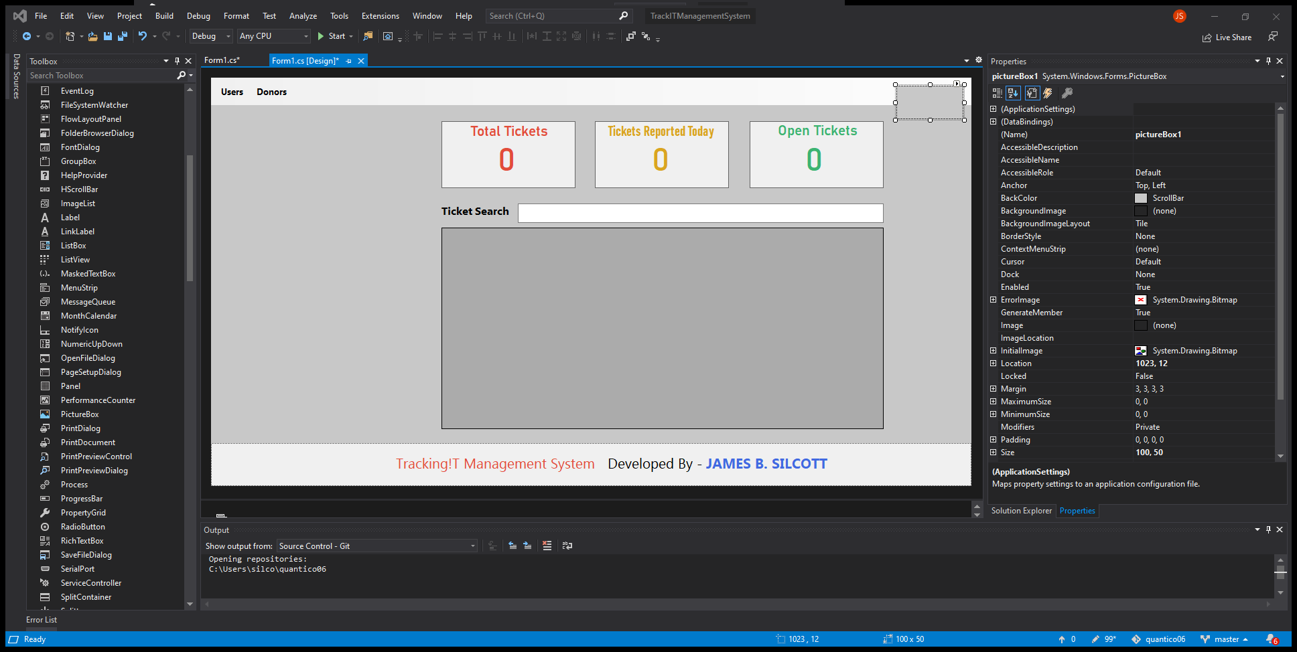
Add Picture Box
Add a Picture Box
Drag and drop a picture box
Change binding name to
pictureBoxClose

Slide 55
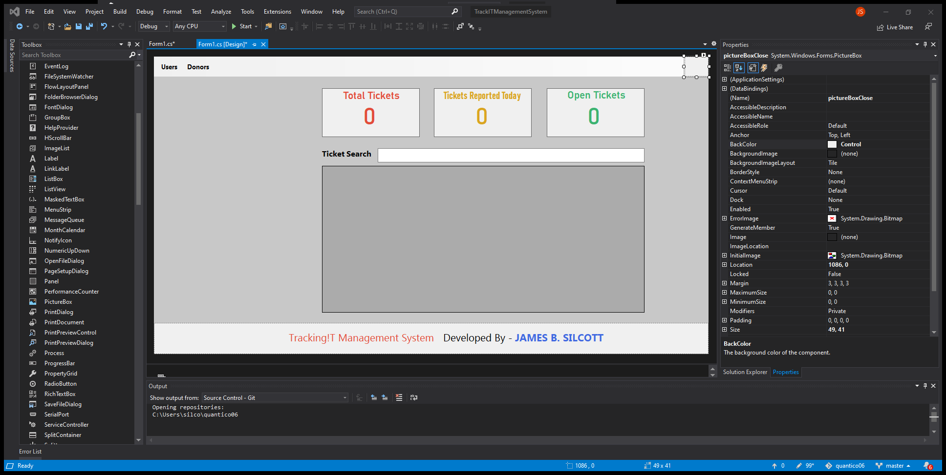
Resize and Change BackColor
Resize and Change Color
Change color to Control

Slide 56
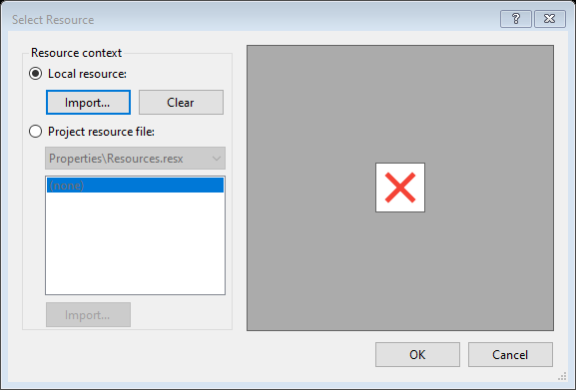
Add Image
Select play button on the picture box
Change to stretch image
Select Choose Image
Local Resource
Import
Search for image icon

Slide 57
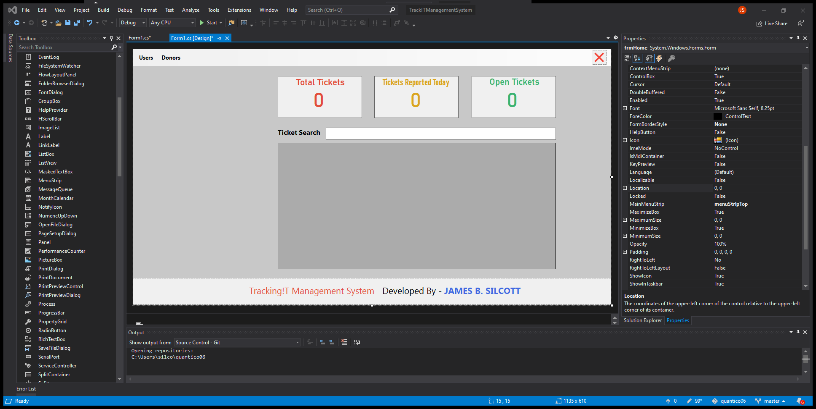
Change Size and Location
Change if needed

Slide 58
Add Function to Close Button
Double Click on the icon

Slide 59
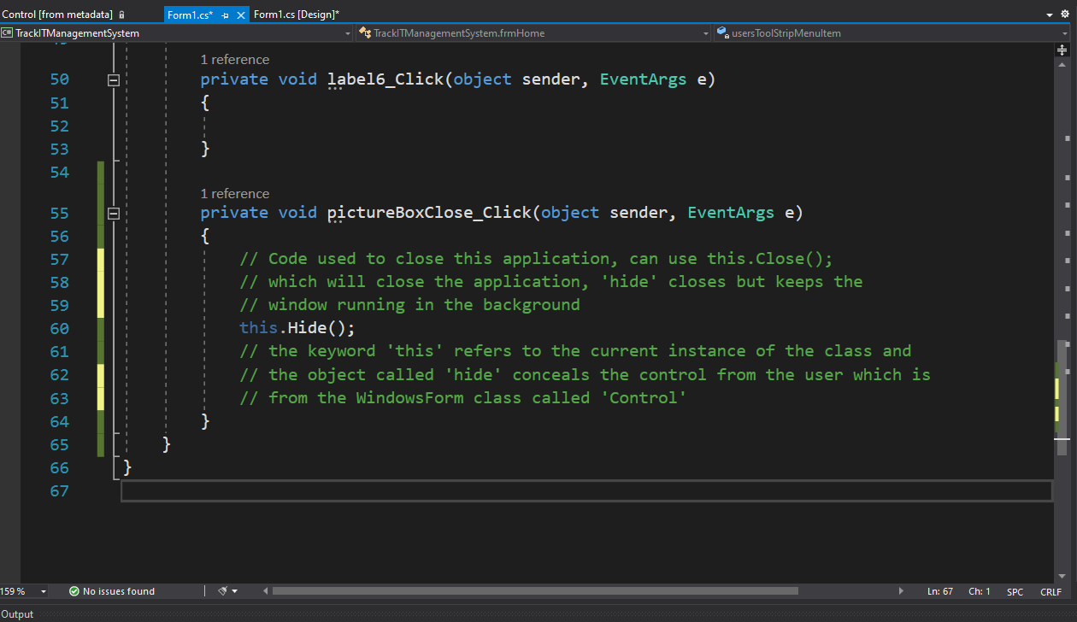
Code Close
Code the following
this.Hide();

Slide 60
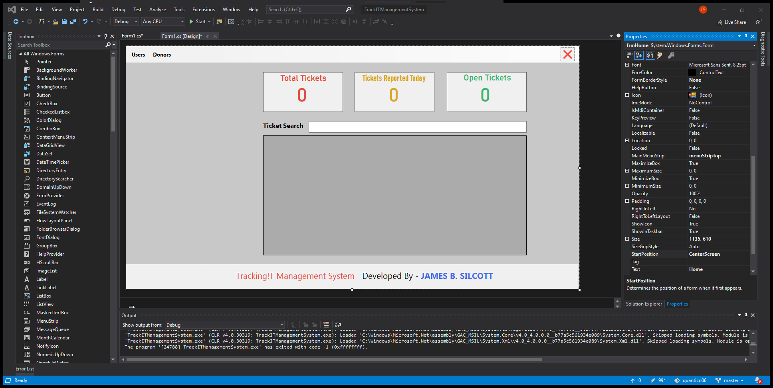
Change Start Position
Select the window
Under Properties change the StartPosition to CenterScreen

Slide 61


Run the Program
Verify the Program Runs
Select the close icon
Stop the program

Slide 62
A STEP-by-STEP Build of this project
1. Design Home Page
2. Create Database in SQL
3. Connecting Database
4. Design Form for Users Module
5. Create Business Logic Layer – BLL
6. Create Methods to Users
7. Adding ADD, UPDATE, DELETE for Users
8. Upload Images
9. Add Search Functionality for Users
10. Design Form for Customer Module
11. Create BLL for Customer Module
12. Create Methods to Customers
13. Create ADD, UPDATE, DELETE for Customers
14. Upload Profile Picture for Customers
15. Refresh Dashboard on Database Change
16. Add Search Functionality for Customers
17. Design Login Form
18. Add Login Functionality
19. Saving and Displaying Logged in Users
20. Create Animated – Loading Progress – Splash Screen
21. Delete Image File
22. Bug Fixing

Slide 63


Open MSQL
Open Microsoft SQL Server Management Studio
Right Click on Databases
Create a database
Name it:
Track!TManagementSystem

Slide 64

Create Tables
Create a Table
Right Click on Tables
Add the columns as shown in picture

Slide 65

Save and Table Name
Save and Table Name
Ctrl-s
Change name to:
tbl_users

Slide 66

Set Primary Key
Set Primary Key
Right click the arrow
Select Set Primary Key

Slide 67

Change Id Specs
Change Property
Under Identity Specification
(Is Identity)
Change to Yes
This will create a unique increment for the user id, which will start from number 1

Slide 68

Refresh Table
Refresh Table
Right Click on the Table Folder
Select Refresh so you can see the new table

Slide 69

Add New Table
Add New Table
Right Click on table folder
New>
Table

Slide 70

Create Requester Table
Build Table
Add the columns as shown in picture

Slide 71
Set Primary Key
Set Primary Key
Right click the arrow
Select Set Primary Key

Slide 72

Change Id Specs
Change Property
Under Identity Specification
(Is Identity)
Change to Yes
This will create a unique increment for the user id, which will start from number 1

Slide 73

Save and Table Name
Save and Table Name
Ctrl-s
Change name to:
tbl_requesters

Slide 74
A STEP-by-STEP Build of this project
1. Design Home Page
2. Create Database in SQL
3. Connecting Database
4. Design Form for Users Module
5. Create Business Logic Layer – BLL
6. Create Methods to Users
7. Adding ADD, UPDATE, DELETE for Users
8. Upload Images
9. Add Search Functionality for Users
10. Design Form for Customer Module
11. Create BLL for Customer Module
12. Create Methods to Customers
13. Create ADD, UPDATE, DELETE for Customers
14. Upload Profile Picture for Customers
15. Refresh Dashboard on Database Change
16. Add Search Functionality for Customers
17. Design Login Form
18. Add Login Functionality
19. Saving and Displaying Logged in Users
20. Create Animated – Loading Progress – Splash Screen
21. Delete Image File
22. Bug Fixing

Slide 75

Add Connection
In Visual Studio
Under Server Explore
Right Click on Data Connections
Add Connection

Slide 76

Select Database
Select the Database
Change Server Name to your local server

Slide 77

Code App Config
Code App Config
Under Solution Explore
Double Click the App Config

Slide 78

Add Connection String
Add Connection String
Type in the following code
This is to add a connection string from our application at startup to the database we created

Slide 79

Get Database Name
Under Server Explorer
Click on the database
Go to Properties
Select the database name
Copy and Paste into the string area

Slide 80
A STEP-by-STEP Build of this project
1. Design Home Page
2. Create Database in SQL
3. Connecting Database
4. Design Form for Users Module
5. Create Business Logic Layer – BLL
6. Create Methods to Users
7. Adding ADD, UPDATE, DELETE for Users
8. Upload Images
9. Add Search Functionality for Users
10. Design Form for Customer Module
11. Create BLL for Customer Module
12. Create Methods to Customers
13. Create ADD, UPDATE, DELETE for Customers
14. Upload Profile Picture for Customers
15. Refresh Dashboard on Database Change
16. Add Search Functionality for Customers
17. Design Login Form
18. Add Login Functionality
19. Saving and Displaying Logged in Users
20. Create Animated – Loading Progress – Splash Screen
21. Delete Image File
22. Bug Fixing

Slide 81

Rename Form
Rename Form
Under Solution Explorer
Right Click on Form.cs
Rename to:
frmHome

Slide 82

Create Folder
Create a Folder
Right Click on the Program Name
Add
New Folder
Rename it to UI

Slide 83

Move Form
Move Form
Select frmHome and drag into the UI folder

Slide 84

Add Form
Add a Form
Select UI Folder
Right Click on it
Select Add
New Item

Slide 85

New Form
Add New Form
Select Form (Windows Form)
Change Name to:
frmUsers.cs

Slide 86

Change Text
Change Text
To:
Users

Slide 87

Change Border
Change Border
To:
None

Slide 88

Resize
Change Size
1100, 500

Slide 89

Change Background
Change Back Color
Select:
Scrollbar

Slide 90

Add Panel
Add a Panel
Drag and drop a panel
Rename databinding to :
panelTop

Slide 91

Change Color
Change Panel Color
Select BackColor:
Salmon

Slide 92

Change Dock
Change Dock
Select:
Top
Resize

Slide 93


Add Label
Add a label
Drag and drop a label inside the panel
Change Name to:
lblFormTitle
Change font: Segoe UI, Bold, 14
Rename to:
Manage Users

Slide 94

Add Label
Add a label
Drag and drop a label
Change Binding Name to:
lblProfilePicture
Change font: Segoe UI, Bold, 14
Rename to:
Profile Picture

Slide 95

Add Picture Box
Add a Picture Box
Drag and drop a Picture Box
Change Size Mode:
to
StretchImage
Rename Binding name to:
pictureBoxProfilePicture

Slide 96

Add Button
Add a Button
Drag and drop a button
Change Binding Name to:
btnSelectImage
Change font: Segoe UI, Regular 10
Change Flat Style to:
Flat
Rename to:
Select Image

Slide 97

Add Label
Add a label
Copy and Paste the Profile Picture Label
Change Binding Name to:
lblFullName
Change Text Name:
Full Name

Slide 98

Add Text Box
Add a Text Box
Drag and drop a text box
Rename Binding to:
txtFullName
Font: Segoe UI, 10

Slide 99

Add Label and Text Box
Add a label and Text Box
Copy and Paste the last Label and Text Box
Ctrl-c
Ctrl-v
Change binding name for label to:
lblUserID
Change label Name to:
User ID
Change TextBox binding name to:
txtUserID
Change ReadOnly to:
True
This won’t allow anyone to change the USerID

Slide 100

Add Label and Text Box
Add a label and Text Box
Copy and Paste the last Label and Text Box
Ctrl-c
Ctrl-v
Change binding name for label to:
lblEmail
Change label Name to:
Email
Change TextBox binding name to:
txtEmail

Slide 101

Add More Labels and Test Boxes
Add a label and Text Box
Two TIMES: Copy and Paste the last Label and Text Box
Ctrl-c
Ctrl-v
Change binding name for label to:
lblUserName
Change label Name to:
Username
Change TextBox binding name to:
txtUserName
Change binding name for label to:
lblPassword
Change label Name to:
Password
Change TextBox binding name to:
txtPassword

Slide 102

Add More Labels and Test Boxes
Add a label and Text Box
Two TIMES: Copy and Paste the last Label and Text Box
Ctrl-c
Ctrl-v
Change binding name for label to:
lblPhone
Change label Name to:
Phone
Change TextBox binding name to:
txtPhone
Change MaxLength to: 15
Change binding name for label to:
lblAddress
Change label Name to:
Address
Change TextBox binding name to:
txtAddress
Change Multiline to:
True
Resize the textbox

Slide 103

Add Button
Add a button
Drag and drop a button
Change binding name to:
btnAdd
Change Text to ADD
FlatStyle to: Flat
Change BackColor to: Green
Change ForeColor to: Control
Change Font:
Segoe UI, SemiBold, 10

Slide 104

Add More Buttons
Copy and Paste
Do this 3 more times

Slide 105

Alter Buttons
Change other buttons
Rename bindings to:
btnUpdate, btnDelete, btnClear
Change Back Colors:
Teal, Crimson, DarkGoldenrod
Change Text Names:
UPDATE, DELETE, CLEAR

Slide 106

Add Data Grid View
Add a Data View Grid
Drag and drop a data grid view
Rename binding to:
dvgUsers

Slide 107

Add Search
Add a label and text box
Copy and paste the full name label and text box
Paste above the DVG and change the:
Binding name to: lblSearch
Text Name: Search
Text binding name: txtSearch:

Slide 108

Change Form Starting Position
Change Form
StartPosition to:
CenterScreen

Slide 109

Code User Page
Code User Page
Double Click on User Name

Slide 110

Code User Form
Code User Form
Insert the following code:

Slide 111

Add Picture Box
Add a Picture Box
Drag and drop a Picture Box
Location: 1135, 610
Size: 35, 35
Change to StretchImage
Import Close Icon

Slide 112

Add Function
Add function to Button
Double Click on Icon

Slide 113

Code Button
Add a label
Code the following:

Slide 114
A STEP-by-STEP Build of this project
1. Design Home Page
2. Create Database in SQL
3. Connecting Database
4. Design Form for Users Module
5. Create Business Logic Layer – BLL
6. Create Methods to Users
7. Adding ADD, UPDATE, DELETE for Users
8. Upload Images
9. Add Search Functionality for Users
10. Design Form for Customer Module
11. Create BLL for Customer Module
12. Create Methods to Customers
13. Create ADD, UPDATE, DELETE for Customers
14. Upload Profile Picture for Customers
15. Refresh Dashboard on Database Change
16. Add Search Functionality for Customers
17. Design Login Form
18. Add Login Functionality
19. Saving and Displaying Logged in Users
20. Create Animated – Loading Progress – Splash Screen
21. Delete Image File
22. Bug Fixing

Slide 115

Add Folder
Add a Folder
Right Click on the program in Solutions Explorer
Add
New Folder
Name it: BLL
Business Logic Layer

Slide 116

Add Class
Add a Class
Right Click on BLL Folder
Add
New Item
Class
Rename it: userBLL

Slide 117

INFO
Look at the server explorer
Under the program you’ll see the table user id that we need to create the BLL from

Slide 118

Create Getter and Setter
Create Get and Set
Type prop
Press tab tab
Tab
Enter
Enter

Slide 119

Create Get & Set
Code
Add the following code
//get is a read only accessor and set is a write only accessor

Slide 120
A STEP-by-STEP Build of this project
1. Design Home Page
2. Create Database in SQL
3. Connecting Database
4. Design Form for Users Module
5. Create Business Logic Layer – BLL, for User Module
6. Create Methods INSERT, UPDATE, DELETE for Users
7. Upload Images
8. Add Search Functionality for Users
9. Design Form for Customer Module
10. Create BLL for Customer Module
11. Create Methods to Customers
12. Create ADD, UPDATE, DELETE for Customers
13. Upload Profile Picture for Customers
14. Refresh Dashboard on Database Change
15. Add Search Functionality for Customers
16. Design Login Form
17. Add Login Functionality
18. Saving and Displaying Logged in Users
19. Create Animated – Loading Progress – Splash Screen
20. Delete Image File
21. Bug Fixing

Slide 121
Add Folder
Add a Folder
Right Click on the program in Solutions Explorer
Add
New Folder
Name it: DAL
Data Access Layer

Slide 122

Add Class
Add a Class
Right Click on DAL Folder
Add
New Item
Class
Rename it: userDAL

Slide 123

Code the DAL
Code the DAL
Insert the following code:

Slide 124

Update References
Update References
Go to solution explorer
Right Click on References
Add Reference
Search for config
Select System.Configuration
Click ok

Slide 125

Add Using
Click on ConfigurationManager name
Select the using phrase to import the using data

Slide 126

Add a Region
Add a Region for better code management
Type the following code:

Slide 127

SELECT Code Try, Catch, and Finally
Code Try, Catch, and Finally
Write the following Code within the region code block:

Slide 128

SELECT Try Code
Add Code in try block
Write the following:

Slide 129

INSERT Code Try, Catch, and Finally
Code Try, Catch, and Finally
Write the following Code within the region code block:

Slide 130

INSERT Try Code
Add Code in try block
Write the following:

Slide 131

UPDATE Code Try, Catch, and Finally
Code Try, Catch, and Finally
Write the following Code within the region code block:

Slide 132

UPDATE Try Code
Add Code in try block
Write the following:

Slide 133

DELETE Code Try, Catch, and Finally
Code Try, Catch, and Finally
Write the following Code within the region code block:

Slide 134

DELETE Try Code
Add Code in try block
Write the following:

Slide 135
A STEP-by-STEP Build of this project
1. Design Home Page
2. Create Database in SQL
3. Connecting Database
4. Design Form for Users Module
5. Create Business Logic Layer – BLL, for User Module
6. Create Methods INSERT, UPDATE, DELETE for Users
7. Adding ADD, UPDATE, DELETE functions for Users
8. Add Search Functionality for Users
9. Design Form for Customer Module
10. Create BLL for Customer Module
11. Create Methods to Customers
12. Create ADD, UPDATE, DELETE for Customers
13. Upload Profile Picture for Customers
14. Refresh Dashboard on Database Change
15. Add Search Functionality for Customers
16. Design Login Form
17. Add Login Functionality
18. Saving and Displaying Logged in Users
19. Create Animated – Loading Progress – Splash Screen
20. Delete Image File
21. Bug Fixing

Slide 136

Code the ADD button
Code Button
Double Click on the ADD button

Slide 137

Code ADD Button
Code the following:
Step 1

Slide 138

Code ADD Button
Code the following:
Step 2 and 3

Slide 139

Hide Password
Hide Password
Go to the User Form
Select the password text box
Under properties
Select the PasswordChar
Insert ‘x’

Slide 140


Code to show Data table in User Form
Go to the btnAdd_click function
Add the following code:
And Call it
Call it

Slide 141

Add Event
Select the DataGridView
Click on the event button
Double Click on the
RowsHeaderMouseClick

Slide 142

Code Event
Code
The Following:

Slide 143

Create Form Load Event
Code
Double Click on the User Form
Code The Following:

Slide 144

Code UPDATE Button
Double Click on Update Button
Code the Following:
Step 1

Slide 145

Code UPDATE Button
Double Click on Update Button
Code the Following:
Step 2

Slide 146

Open the Database Connection
Add Code
Write the following in:
userDal.cs
Under the Update region

Slide 147

Code DELETE Button
Double Click on Delete Button
Code the Following:
Step 1 and 2

Slide 148

Open the Database Connection
Add Code
Write the following in:
userDal.cs
Under the Delete region

Slide 149

Code CLEAR Button
Double Click on Clear Button
Code the Following:

Slide 150

CHANGED Backgrounds
Changed Backgrounds & Colors

Slide 151

CHANGED Backgrounds
Changed Backgrounds & Colors

Slide 152
A STEP-by-STEP Build of this project
1. Design Home Page
2. Create Database in SQL
3. Connecting Database
4. Design Form for Users Module
5. Create Business Logic Layer – BLL
6. Create Methods to Users
7. Adding ADD, UPDATE, DELETE for Users
8. Upload Images
9. Add Search Functionality for Users
10. Design Form for Customer Module
11. Create BLL for Customer Module
12. Create Methods to Customers
13. Create ADD, UPDATE, DELETE for Customers
14. Upload Profile Picture for Customers
15. Refresh Dashboard on Database Change
16. Add Search Functionality for Customers
17. Design Login Form
18. Add Login Functionality
19. Saving and Displaying Logged in Users
20. Create Animated – Loading Progress – Splash Screen
21. Delete Image File
22. Bug Fixing

Slide 153
Code Image Button
Code the change image button
Double click on the button

Slide 154

Code Button
Write this code
This will code the file dialog to open files that are picture extension as assigned
Validate the code by adding a break point (red button on the left had side) this will stop running code in this line

Slide 155


Click Change Image
Select a picture
Select and notice that the Image File path shows what was just created
Jpeg
Jpg
Png
PNG
Gif
Choose a picture that allows the extension

Slide 156

Validate Extension
Validate
Read the values of ext
Should be null

Slide 157

Validate Extension
Validate
Read the values of ext
Should be an extension of the picture you just picked

Slide 158

Create a Random Number
Code the following
Code a random number generator then validate by adding a break point on the new code line
Run the program and load another picture

Slide 159

Validate
Validate
Check the value of the randint you created works by pressing the step into function on top then notice if the value changes randomly

Slide 160


Rename the image
Rename the variable imageName
Eariler we named the imagename
“no-image.jpg”
So when no image is selected it will be called this, but now if it is selected we need to do this:

Slide 161

Validate
Validate the code
Again add a break point then rerun the program and load another image

Slide 162


Validate imageName Change
Validate
Check the value before
Then F11 step into
Check the value afterwards
Should add the
Datetime
Random number between 0-1000
The extension of the file

Slide 163

Add Folder
Add a folder
Under the c# program in solution explorer, right click , then add, then folder
Name it “images”

Slide 164

Code and Break Point
Write the code and set the break Point
This will set the path of the image destination, but first we need to verify he correct string and path name

Slide 165


Check the path value
Check the value
Notice the value before
And
After the step into

Slide 166

Remove String Chars
To see these folder click on
Show all folders
Then return to normal view
Remove the string characters from the path
The path sets it automatically to include the bin/DeBug folder as the set path
In order to remove this we need to minus these characters int eh string
Which is minus ten

Slide 167
Minus Character in Path
Minus Characters
Subtract 10 from the string to remove the bin/Debug
Set another break point and validate eh path shows the removed characters

Slide 168

Code the final path and MessageBox
Code the following
Insert code for the it to add the images folder path tot eh string
Use file class to copy the file from open filename path to new path created
Code the messagebox to show success

Slide 169

Validate
Run the program
Select an image and load in all the info

Slide 170

Code the no-image path
Code the following
Assign the path
Give it the image folder path
Assign the value to the pictureBox
Do the same for the no image (else statement)

Slide 171

Code the Clear Method
Code the following
This will allow the image to be cleared with selected

Slide 172

Rename No Image File
Select and rename file
Find n image you want to be the default image on startup and then rename it “no-image.jpg”
Make sure it is located inside the image folder you created

Slide 173

Validate
Run the program and validate
Error and fix
Received Not Supported Exception
View details
Says The path given format is not supported

Slide 174

DeBug
Set a Break Point
Rerun the program
Select on the user again then step into a few times to reach the pictureBoxProfilePicture.Image path

Slide 175

DeBug
The image path is different
Notice the image path has the datetime as a folder path
This is due to the index 7 of the row we created is for datetime value not the image path

Slide 176

Validate
Run the program and validate
Error and fix
Change the value of the index to 8 instead of 7
Rerun and validate
It should store the image now

Slide 177
A STEP-by-STEP Build of this project
1. Design Home Page
2. Create Database in SQL
3. Connecting Database
4. Design Form for Users Module
5. Create Business Logic Layer – BLL
6. Create Methods to Users
7. Adding ADD, UPDATE, DELETE for Users
8. Upload Images
9. Add Search Functionality for Users
10. Design Form for Customer Module
11. Create BLL for Customer Module
12. Create Methods to Customers
13. Create ADD, UPDATE, DELETE for Customers
14. Upload Profile Picture for Customers
15. Refresh Dashboard on Database Change
16. Add Search Functionality for Customers
17. Design Login Form
18. Add Login Functionality
19. Saving and Displaying Logged in Users
20. Create Animated – Loading Progress – Splash Screen
21. Delete Image File
22. Bug Fixing

Slide 178

Add Search Method
Code the following
Under userDal
This will add the Search functions and set up the database connection needed for the search

Slide 179

Code Search Box
Code the Search Box
Double Click on the search box

Slide 180

Code the Search Box
Code the following
This will set the object to a sting keywords
If statement for is not null then search the keywords
Else select the data from the database

Slide 181

Validate
Run the program and validate
Type in a new user and search for them it should show that user

Slide 182
A STEP-by-STEP Build of this project
1. Design Home Page
2. Create Database in SQL
3. Connecting Database
4. Design Form for Users Module
5. Create Business Logic Layer – BLL
6. Create Methods to Users
7. Adding ADD, UPDATE, DELETE for Users
8. Upload Images
9. Add Search Functionality for Users
10. Design Form for Ticket Module
11. Create BLL for Customer Module
12. Create Methods to Customers
13. Create ADD, UPDATE, DELETE for Customers
14. Upload Profile Picture for Customers
15. Refresh Dashboard on Database Change
16. Add Search Functionality for Customers
17. Design Login Form
18. Add Login Functionality
19. Saving and Displaying Logged in Users
20. Create Animated – Loading Progress – Splash Screen
21. Delete Image File
22. Bug Fixing

Slide 183

Create New Form
Create a new form
Under the UI folder, right-click
Add new item
Select Windows Form
Name it frmRequesters

Slide 184

Resize
Resize the new form
Change to 1135, 610

Slide 185

Change Properties
Rename text of form
Change name to Create Tickets
Change FormBorderSytle to none
Change backgroundimage to a picture
Change to stretch image

Slide 186

Copy/Paste Top
Copy and paste
From the Mange User form
Copy and paste the
top panel
Text box
Back button

Slide 187

Rename Text
Rename the text box
Name it
CREATE TICKETS

Slide 188

Copy and Paste
Select the rest form the User Form
Copy and Paste

Slide 189

Change Properties
Change the following properties
Rename user id to Ticket ID and the label name to lblTicketID
Change things to match the picture

Slide 190

Create Checked List Box
Drag and drop a checked list box for Issue Category
Enter the strings of selections

Slide 191

Create List Box
Create a List Box for Priority Level
Drag and drop a list box
Enter the string names in the selection list

Slide 192


Code Create Ticket Button
Double Click on the name
Create Tickets

Slide 193

Change Start Position of Form
Change the start position
Under form properties
StartPostion
Select
Center Screen

Slide 194
A STEP-by-STEP Build of this project
1. Design Home Page
2. Create Database in SQL
3. Connecting Database
4. Design Form for Users Module
5. Create Business Logic Layer – BLL
6. Create Methods to Users
7. Adding ADD, UPDATE, DELETE for Users
8. Upload Images
9. Add Search Functionality for Users
10. Design Form for Ticket Module
11. Create BLL for Ticket Requester Module
12. Create Methods to Customers
13. Create ADD, UPDATE, DELETE for Customers
14. Upload Profile Picture for Customers
15. Refresh Dashboard on Database Change
16. Add Search Functionality for Customers
17. Design Login Form
18. Add Login Functionality
19. Saving and Displaying Logged in Users
20. Create Animated – Loading Progress – Splash Screen
21. Delete Image File
22. Bug Fixing

Slide 195

Create New Class
Create a new class
Named requestersBLL

Slide 196

Code the BLL
Code the Business Logic Layer for the Ticket Requestors
Write the following code
Helpful tip: use
Type: ‘prop’ + tab + tab
For the property shortcut

Slide 197
A STEP-by-STEP Build of this project
1. Design Home Page
2. Create Database in SQL
3. Connecting Database
4. Design Form for Users Module
5. Create Business Logic Layer – BLL
6. Create Methods to Users
7. Adding ADD, UPDATE, DELETE for Users
8. Upload Images
9. Add Search Functionality for Users
10. Design Form for Ticket Module
11. Create BLL for Ticket Requester Module
12. Create Methods to Ticket Requester
13. Create ADD, UPDATE, DELETE for Customers
14. Upload Profile Picture for Customers
15. Refresh Dashboard on Database Change
16. Add Search Functionality for Customers
17. Design Login Form
18. Add Login Functionality
19. Saving and Displaying Logged in Users
20. Create Animated – Loading Progress – Splash Screen
21. Delete Image File
22. Bug Fixing

Slide 198

Create the SQL connection
SELECT QUERY
Copy and paste the following

Slide 199


Create the SQL connection
INSERT QUERY
Copy and paste the following

Slide 200


Create the SQL connection
UPDATE QUERY
Copy and paste the following

Slide 201

Create the SQL connection
DELETE QUERY
Copy and paste the following

Slide 202
A STEP-by-STEP Build of this project
1. Design Home Page
2. Create Database in SQL
3. Connecting Database
4. Design Form for Users Module
5. Create Business Logic Layer – BLL
6. Create Methods to Users
7. Adding ADD, UPDATE, DELETE for Users
8. Upload Images
9. Add Search Functionality for Users
10. Design Form for Ticket Module
11. Create BLL for Ticket Requester Module
12. Create Methods to Ticket Requester
13. Create ADD, UPDATE, DELETE for Customers
14. Upload Profile Picture for Customers
15. Refresh Dashboard on Database Change
16. Add Search Functionality for Customers
17. Design Login Form
18. Add Login Functionality
19. Saving and Displaying Logged in Users
20. Create Animated – Loading Progress – Splash Screen
21. Delete Image File
22. Bug Fixing

Slide 203
Validate
Run the program and validate
Error and fix

Slide 204
Validate
Run the program and validate
Error and fix

Slide 205
Validate
Run the program and validate
Error and fix

Slide 206
Validate
Run the program and validate
Error and fix

Slide 207
Validate
Run the program and validate
Error and fix

Slide 208
Validate
Run the program and validate
Error and fix

Slide 209
Validate
Run the program and validate
Error and fix

Slide 210
Validate
Run the program and validate
Error and fix

Slide 211
Validate
Run the program and validate
Error and fix

Slide 212

Add Label
Add a label
Drag and drop a label inside the panel

Slide 213

Change Back Color
preview.codecanyon.net/item/feedback-bug-tracker-management-tool/full_screen_preview/11449687?_ga=2.151661177.1905950628.1594668803-1210016305.1594668803
Change Window BackColor
Use drop down and select ScrollBar

Slide 214

Change Back Color
preview.codecanyon.net/item/feedback-bug-tracker-management-tool/full_screen_preview/11449687?_ga=2.151661177.1905950628.1594668803-1210016305.1594668803
Change Window BackColor
Use drop down and select ScrollBar
preview.codecanyon.net/item/recipe-builder-user-management-system/full_screen_preview/17527249?_ga=2.230619996.1592419295.1594669034-1210016305.1594668803

Slide 215
codecanyon.net/item/recipe-builder-user-management-system/17527249
codecanyon.net/item/project-box-team-management-tool/8103343?s_rank=13

Slide 216

Change Back Color
Change Window BackColor
Use drop down and select ScrollBar

Slide 217

Change Back Color
Change Window BackColor
Use drop down and select ScrollBar
ticketTotal
ticketTotalReportedToday
ticketOpen
ticketCompleted

Slide 218

Change Back Color
Change Window BackColor
Use drop down and select ScrollBar

Slide 219



Slide 220


Slide 221



